Slide 1

ORAL HISTORY MADE EASY
WEEK 3: Applying an ethical approach throughout
Sunday 23rd March 2025 14.00 hrs GMT
With DR ANGELA MAYE-Banbury BA MSc PhD SFHEA
ORAL HISTORIAN & EMERITUS FELLOW IN ORAL HISTORY

Slide 2
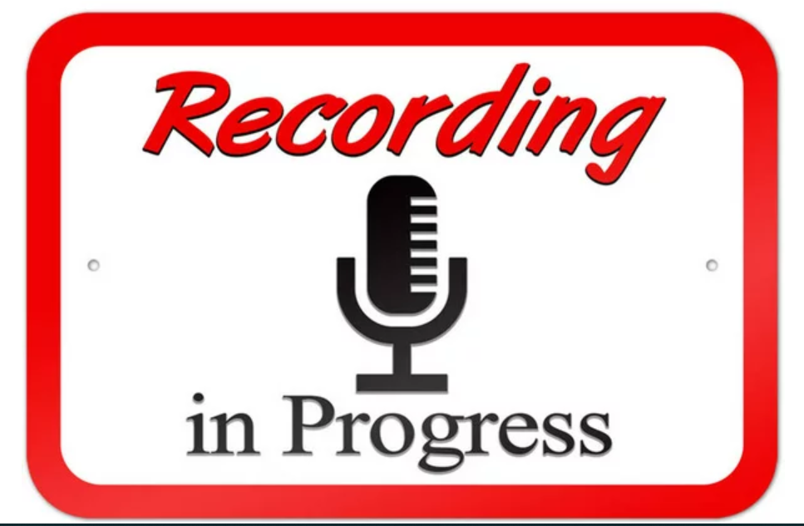

Slide 3
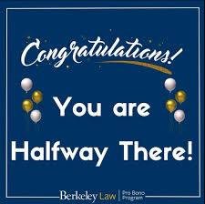
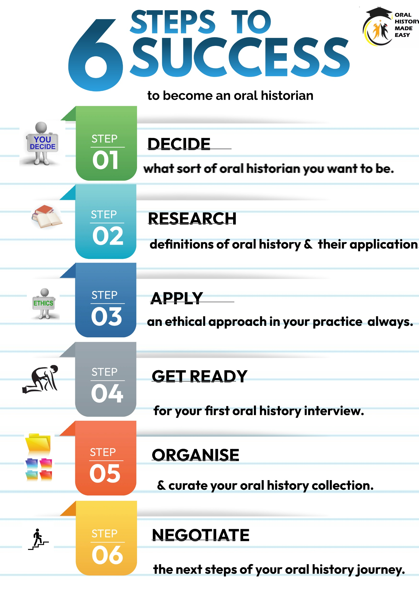

Slide 4

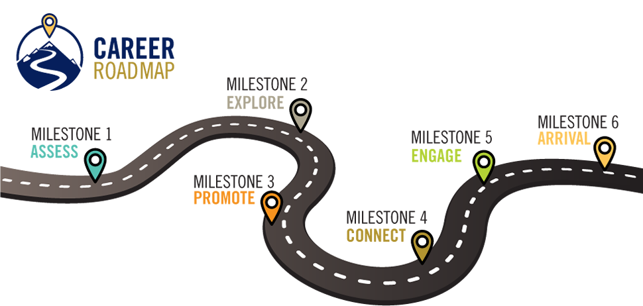
Your development journey, your way
Your past, present and future experiences

Slide 5

What we will have achieved at the end of today’s session
Feedback on last week’s exercise: listening challenge and oral history organisations.
Equipment you will need for your recordings.
The evolution of ethics – the importance of the principles of beneficence and malfeasance and a note on knowledge creation.
Ethics in action for the oral historian: principles of informed consent; assignment of copyright; the participant information sheet; gatekeeper protocol; interviewee summary sheet; consent to use images or other materials;
risk assessment; interview dynamics; incentives or bribes?
Vulnerable participants and research sensitivities; your health and wellbeing as an oral historian.
*Disclaimer: seek legal advice when needed and OHME cannot accept liability.

Slide 6
YOUR FEEDBACK ON LAST WEEK’S TASKS

Slide 7

The listening challenge
In pairs in Zoom rooms, ask your partner:
What went well in your listening exercise?
What would you do differently next time?
Listen carefully to your partner’s reflections and make notes as you will report back on your partner’s experiences. Then swap around.

Slide 8
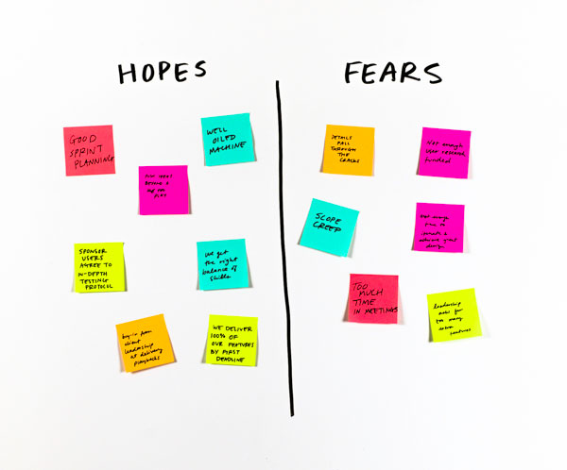
Hopes and fears

Slide 9
Hopes and fears
Concerns about equipment | Practice using the Zoom/Tascam equipment inc memory card. Always have a back up. Check batteries/mains supply.
No-one will be interested in the collection. | Be assured their will be a high level of interest in your oral histories. People’s stories drawn us in. Claim the identity of the oral historian as you become increasingly accomplished in the field.
Protecting the interviews I have done | Ensure proper recording format, downloading and curation (week 5). Have a succession plan and digital curation plan in place. An oral history interview is like a message in a bottle – you never know where it is going to end up.

Slide 10
EQUIPMENT YOU WILL NEED

Slide 11
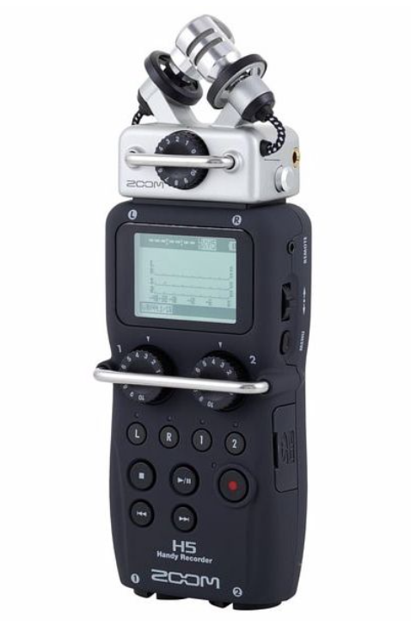
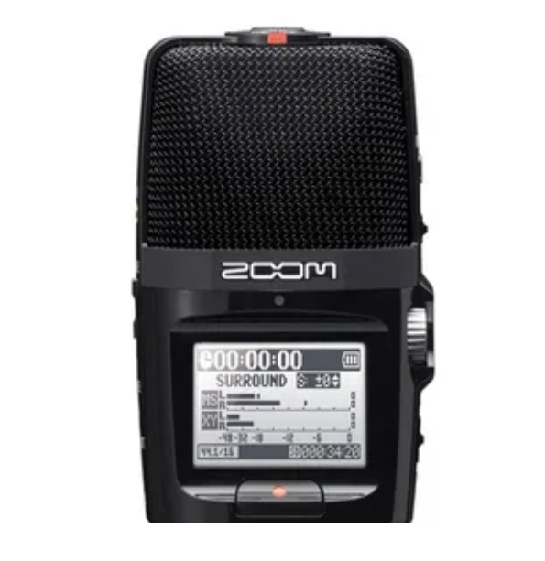
Your recording equipment (1)
Standard recorders for oral history (archival quality) are: Zoom H1; Tascam DR-05; Zoom H2n (my favourite); Zoom H4n; Tascam DR-40; Zoom H5; Zoom H6; Roland R-26 and Tascam DR100 mk1.

Slide 12
Your recording equipment (2)
The British Oral History Society advocates the use equipment such as the Zoom 5 or Zoom H2N recorder which allows for recording in stereo using two external microphones using .wav format so sound files may then be curated on multiple hard drives.
Be able to record uncompressed PCM WAV (or .wav) files at 44.1kHz 16 bit and/or 48kHz 16bit. This is a good standard of recording quality using a widely recognised format.
Three hours of stereo audio at 48kHz/16bit roughly equates to 2GB of storage space on a memory card (different recorders use different types of card).
Have a USB2 connection to allow the recorded files to be uploaded easily to a computer for renaming, security copying and long-term storage.

Slide 13
Your recording equipment (3)
Recording equipment which saves to .wav format and had ideally with two external mics (Zoom) and USB port. Zoom online also works well with basis safeguards in place. H2N Handy Zoom recorder.
Back up or alternative recording device e.g. IPad or smart phone; dictaphone or other digital recording device. Check you have enough memory (memory cards) Make sure you can get your recording off your equipment.
Editing software e.g. Wavelab; Audacity.
External mic and stand; rubber pad for recorder (a mouse pad or book works well).
Headphones to check sound levels.
Batteries (inc spare) and power supply.

Slide 14
Your recording equipment (4)
Practise using your recording equipment until you feel confident setting up, recording and downloading your interviews.
See https://le.ac.uk/emoha/how-to-do-oral-history/equipment/sound-recorders

Slide 15

Other equipment you will need on the day
Note pad and pens.
Mobile phone and charger (on silent); plane mode.
Your list of questions – try and memorise your key themes so you can focus on your interviewee.
Any visual prompts such as photographic materials.
Bottle of water.
Throat lozenges e.g. Vocalzone or Fishermen's Friends.
Remember your own health and well being.

Slide 16

Preparing your questions
Oral history interviews are a dialogue and therefore should be a natural exchange. But as a 'conversation with a purpose,' you will need a set of questions.
Research your oral history topic. Use Google Scholar to guide you towards peer reviewed research.
Create a topic guide which will act as a road map for you and your interviewee. Be prepared to improvise when needed.
Use open ended questions. Tell me about your first memory of…Describe the place you lived in when…What was that like? Why do you think…?

Slide 17
THE EVOLUTION OF ETHICS & A NOTE ON KNOWLEDGE CREATION

Slide 18
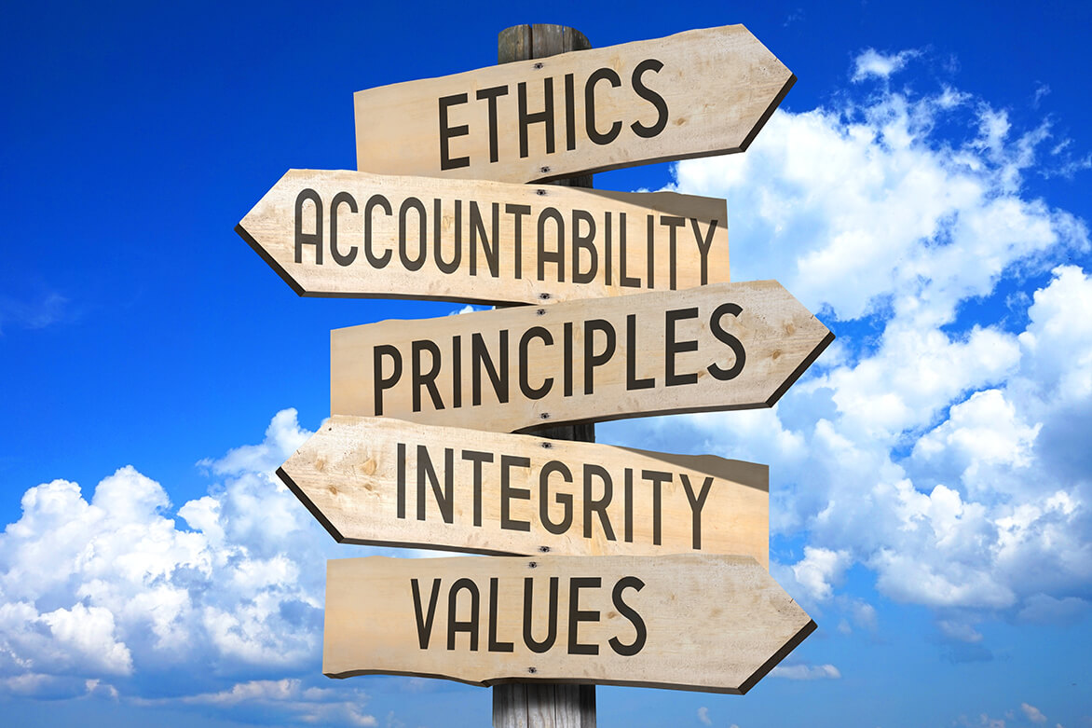

Slide 19
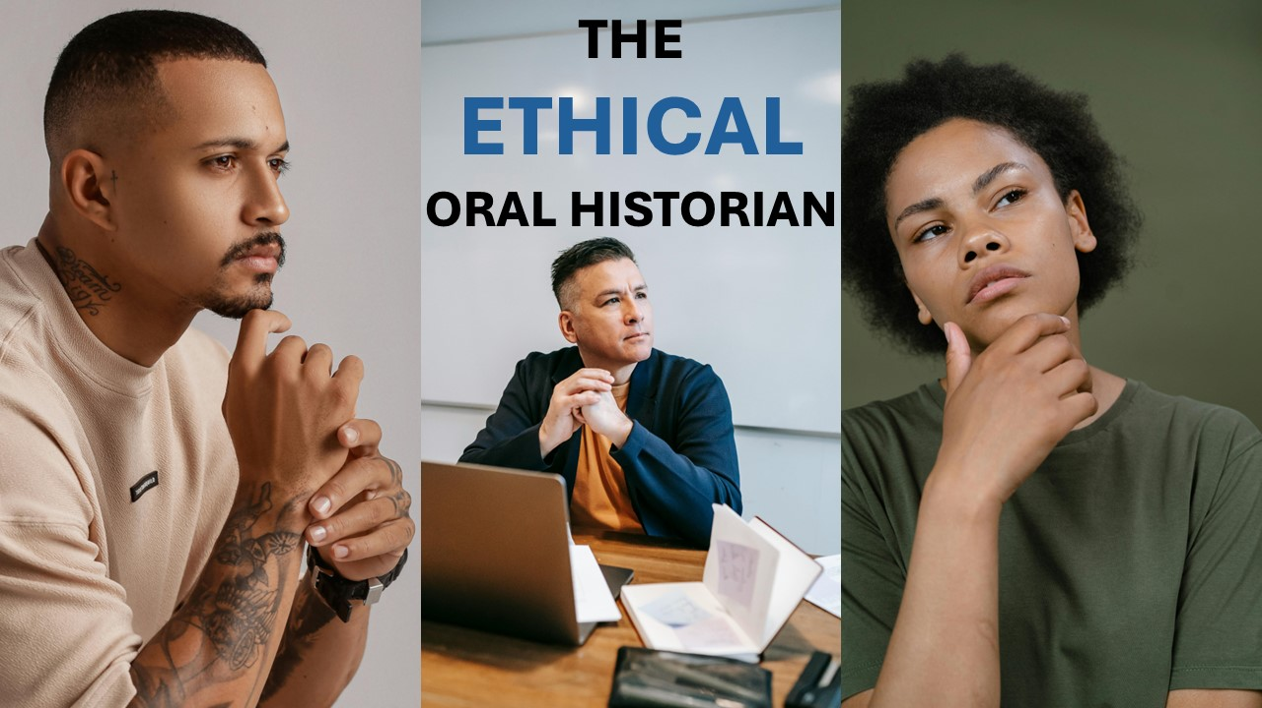

Slide 20
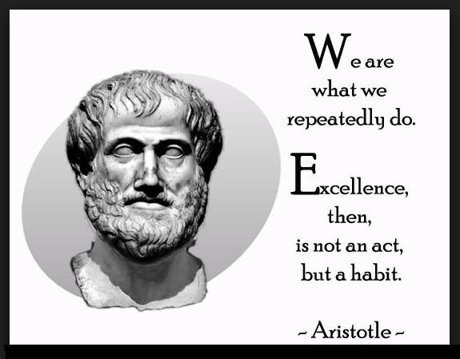
Introduction to ethics
Aristotle's ethics, or study of character, is built around the premise that people should achieve excellence in character by practicing virtue. This was the route which led ultimately to happiness and well-being (eudaimonia). We are what we do.
Underpinned by the two principles of:
Beneficence: to do good
Malfeascence: to cause no harm.

Slide 21

A note on knowledge (1)
Oral history is used to give voices to those whose voices have been hidden from history or are deliberately unheard.
But researchers control over research design, data collection, interpretation and dissemination.
Since research is imbued with power and hierarchies it is a ‘site of struggle’, oral history can also be used to speaking for the ‘Other’ and in doing so, perpetuate systemic inequalities.
Move to co creation and community based approaches to document lived experiences so we are accountable.
How will the oral histories be used? A critical perspective is needed when considering the rhetoric around oral history and its claim that it transforms and empower people’s lives (in most cases, in does not).

Slide 22
A note on knowledge (2)
Ensure you have an on-going dialogue with your oral history participants: respect, reciprocity, responsibility and accountability.
Take the time to cultivate meaningful relationships with participants.
What your research will contribute to cultural community memory.
Informed consent is crucial in oral history.

Slide 23
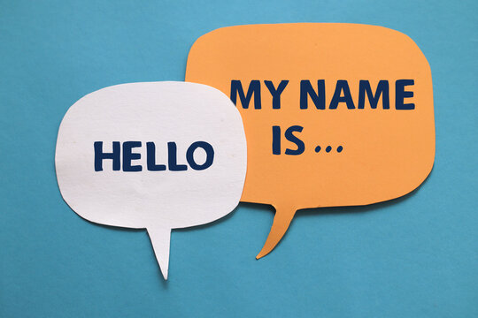
Waiving anonymity – implications for your participant
Remember people are sharing their stories are waiving the right to anonymity and the ‘right to be forgotten.’
How would you feel if you were invited to share your oral history?

Slide 24

Narrator’s ‘Bill Of Rights’
Choose when, where, how and if to tell my story
Ask who the audience is, how the story will be used,
Ask for safety and physical security in an open environment when I speak
Answer only questions that I am comfortable with
Use discretion in order to protect myself, my loved ones and our personal information
Ask for editing rights so I am recognized and identified as I choose
Not be expected to represent experiences that are not my own
Opt out at any time
Amended from ‘Storytellers Bill of rights’, Immigrants Rising

Slide 25
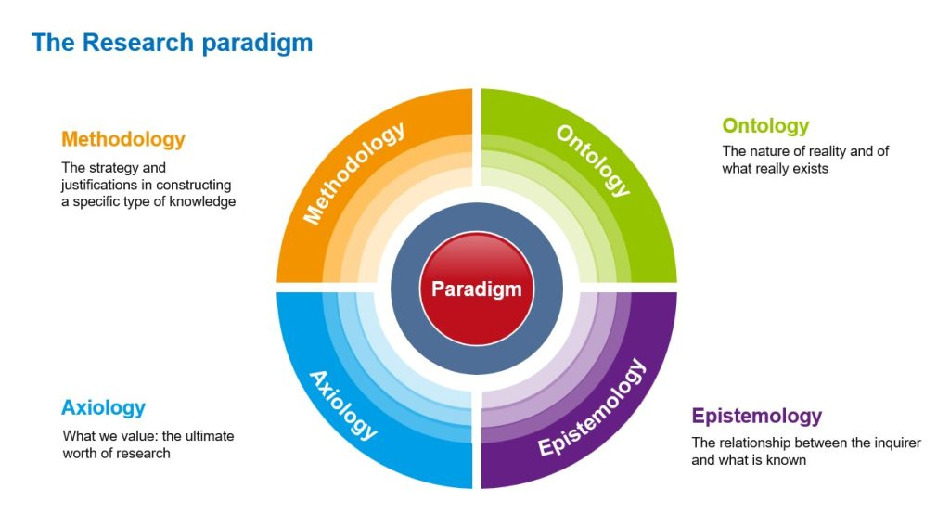
The nature of existence and what is real; the science of being. “Something tastes sweet.”
The study of knowledge & how we know it
e.g. levels of reliability. “The reason this tastes sweet is…”

Slide 26
ETHICS IN ACTION FOR THE ORAL HISTORIAN

Slide 27

Your project design
Your project title
Topic/purpose
Methodology
Scope, time and place.
Potential narrators.
Selected archives
Planned outcomes.
Timeframe for completion.

Slide 28
Ethics in action for the oral historian
ESSENTIAL ETHICS FOR THE ORAL HISTORIAN
1.Interviewees need to have confidence & trust in you as the oral historian: you need to safeguard your reputation for trustworthiness.
2.Recordings should only be made available in a legal & ethical framework which protects the interviewee. Note that in oral history we seek to work above minimal levels of compliance.
4. The oral historian’s intentions regarding how the recordings will be used must be made transparent from the outset to the interviewee to secure informed consent. Respect participant’s perspective.
3.Oral historians need to be aware of the imbalance of power that often exists between interviewee and interviewer. Health, safety and wellbeing need to be uppermost.
Oral History Society (2019)

Slide 29
Essential ethics terminology for oral historians
ANONYMITY
Where the participant wants to remain anonymous or use a pseudonym where there is no identifiable information.
CONFIDENTIALTY
Cannot be guaranteed as oral history interviews can be accessed with a subpoena. See Boston College case
COPYRIGHT
The exclusive legal right to reproduce, publish, sell, or distribute the matter and form of something (such as a literary, musical, or artistic work).
DEED OF GIFT
How the narrator would like materials or rights related to an oral history to be managed as a donated collection with no reciprocal act in place.
RELEASE FORM
The agreements in which assignment of intellectual property rights and copyright is stated.
INFORMED CONSENT
The agreement that documents the narrator has been given all the information necessary to decide whether to participate in the oral history project.
ACCESS
How the interview may be accessed; in what format; for how & with any restrictions.
ARCHIVES
How the interview will be stored and in what format; levels of access & any restrictions.

Slide 30
LEVELS OF DISCLOSURE
Full disclosure (public oral history projects)
Full disclosure; interviewees identified with account as audio/audio visual available in public depository and/or public domain; verbatim transcripts made available in public domain; informed consent in writing and on recordings.
Anonymised account in transcript form but made available in public depository and/or public domain; personal identifiers removed; informed consent in writing and on recordings.
Names and person images used; sensitive themes omitted published in journals and other outputs. informed consent in writing and on recordings.
All names and personal identifiers removed; published in research journals and other outputs. This level of disclosure was used in the study. informed consent in writing and on recordings.
So this is the level of consent often needed in oral history
Negligible disclosure

Slide 31
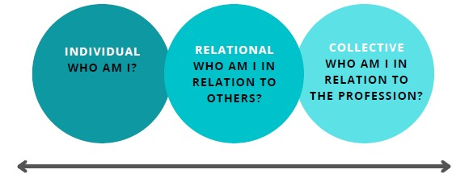
Being clear about your own role and identity
Be clear that you are in the role of the oral historian. In some instances, this may require a renegotiation of your own identity with your interviewee, especially if they know you from another context e.g. community worker; volunteer.
Be prepared to manage your interviewee’s expectations especially if they have known you in another role other than that of oral historian.

Slide 32
Ethics in action (1)
Ethical principles need to be embedded in research design, including relationship between interviewee and interviewer.
Particularly important in a closely knit community, especially the one in which we live.
Principles of beneficence (do good) and malfeasance (do no harm) by using an inductive and contingent approach.
Informed consent (information sheet and consent to participate sent in advance.
Participant data summary sheet completed before the interview
Deed of gift/assignment of copyright signed after the interview
Degrees of disclosure depend on how you want to use the oral histories e.g. waiving anonymity with full consent is standard in oral history; implications for confidentiality.

Slide 33
Ethics in action (2)
Your and your interviewee's needs must always come first: health, well being and safety. We must not revictimize people who may already have experienced trauma. Reliving a memory under a different gaze may cause trauma.
Privileged position of the researcher: interviewees as "people without power in the social world who would be confronted by researchers 'studying down' from their “superordinate and socially distant positions” (Jaffe and Miller 1994, p. 55).
"If people are lonely, do they consent to be interviewed because of the social interaction it provides them?'' (Russell, 1999). the perils of “faking friendship” (Duncombe and Jessop, 2002).
The perils of having “instrumental” relationships i.e. means to an end of human relationships (Mauthner, Birch Jessop & Miller, 2002).

Slide 34
The documentation you will need
The participant information sheet
The gatekeeper protocol
Agreement to participate
Recording agreement (signed after the interview).
Consent to use images
See exemplars UK, Ireland, USA and Canada

Slide 35

How do you intend to use your interviews?
If your intention is to be placed in a public archive, check what documentation the archive needs.

Slide 36
Data protection regulations Ireland & USA
Europe | USA
Scope: Detailed and far reaching legislation which allows individuals ‘the right to be forgotten’. applies to any organisation that is established in the EU, offers products or services in the EU. | Scope apples to companies that conduct business in the relevant state and meets thresholds of revenue.
Key legislation General Data Protection Regulations (GDPR) 2018 | Key legislation: California Consumer Privacy Act (CCPA), as amended by the California Privacy Rights Act (CPRA) & equivalent in selected US states. the CCPA adopts terms like "business", "service provider", and "personal information" while the other state laws adopt GDPR terms like "controller", "processor" and "personal data".
Remove my interview In the EU under GDPR, regretful narrators now have recourse, and businesses can be fined 4% of their revenue for not complying with GDPR regulations. If anonymous, you need to remove all personal identifiers. Consider having a cooling off period. | Remove my interview As long as informed consent was granted (in writing) there is no legal mandate to comply with an interviewee’s request to take down an interview on live or remove from an archive. But to be prudent, you may wish to comply with the interviewee’s request. Consider having a cooling off period.

Slide 37
Essential documentation for oral historians
Ireland, UK Europe | USA
RECOMMENDED: Risk assessment | RECOMMENDED: Risk assessment
STEP1: The participant information sheet and gatekeeper protocol (if latter needed). | STEP 1: The participant information sheet and gatekeeper protocol (if latter needed)
STEP 2: The ‘consent to participate’ document. | STEP 2: The ‘ informed consent’ document
STEP 3: The ‘assignment of copyright/permission’ document. | STEP 3: The ‘deed of gift’ document
STEP 4: Permission to use images | STEP 4: Permission to use images
STEP 4: Interviewee data sheet | STEP 4: interviewee data sheet

Slide 38
Habitus: Oral historian mindset. Ethics as starting point. Do risk assessment.
Identify participant/gatekeeper organisation. Verify non vulnerable interviewee.
Make contact with participant. Ensure transparency and build trust/rapport.
Go through participant sheet. Answer all questions . Secure consent to participate.
Conduct interview. Complete written deed of gift (USA) or recording/copyright agreement (Ireland/UK) after interview. Obtain written consent to use images
Explain next steps to interviewee including verification of transcript and making available. Follow through
ORAL HISTORY AND ETHICS FLOW CHART

Slide 39

Keeping your data secure
Password protected storage.
Back up on hard drive.
Avoid the use of third party software for transcription as companies are likely to be able to access the data. Your interviewee’s interview data may end up in Chat GBT or similar.
If you subcontract to a transcription company, ask them to sign an NDA/confidentiality agreement.
Only publish/archive after your interviewee has read verbatim transcript and signed off and (ii) you have done a sensitivity audit on the transcript.

Slide 40


Why we can never promise confidentiality - the Boston College case
In 2014, the Police Service of Northern Ireland (PSNI) secured court orders for access to interviews that were carried out during the Boston College Belfast Project.
Claim that material may be relevant to the ongoing investigations into unsolved crimes that were committed during the Northern Ireland Troubles. Not deemed as admissible.
Boston College Belfast Project had given categorical undertakings to interviewees that their interviews would remain closed until their deaths.
No confidentiality agreement or deposit agreement supersedes the law of the state. Any risk must be fully discussed with the participant. Legal advice may be needed in certain circumstances.
OHNI statement on Boston College case

Slide 41

How do I evidence informed consent?
In addition to written consent, it is good practice to record the person giving their consent at the beginning of the recording. You then go into your introductory ’script’ (see next slide )
Practical Guidelines - Oral History Network of Ireland (oralhistorynetworkireland.ie)
https://oralhistorynetworkireland.ie/practical-guidelines

Slide 42

Peer review checks on ethics documentation
In general, if you are conducting oral history whilst an employee of a higher education institution or other public bodies, you are likely to need to obtain ethical approval from your employer and/or organisation.
https://oralhistory.org/oha-statement-on-ethics/

Slide 43

What is informed consent?
(2)
Have a script for the beginning of each interview which you use consistently throughout your project. e.g. “My name is (x) and today is (day)(month)(year)(time 24 hr clock) and I am here with (insert name) at (insert location) to record their oral history. Can I check, please, that you have read through the participant information sheet and that I have your consent to record your memories of (insert theme)? Thanks very much.”
Never ask an interviewee to confirm their date of birth, contact details or home address on a recording as this is protected under data protection regulations. We will come back to this in week 4.

Slide 44

What is ‘informed consent’ (1)?
“An agreement that documents, verbally or in writing, that the narrator has been given all the information necessary to come to a decision about whether to participate in the oral history project. Informed consent does not cover or deal with copyright. The interview process must be transparent, with ongoing participation, consent, engagement, and open discussion among all parties, from the first encounter between interviewer and narrator to the creation of end products. Informed consent plays a key role in ensuring transparency.”
Ontario Museum association 2023 – Practical Approaches To Ethical Oral History
(Oral History Association, 2024).

Slide 45

Incentives or bribes?
Much debated in the world of research as it may compromise people’s ability to give their informed consent freely.
When does an incentive e.g. financial incentive become a bribe?
Research evidence shows that research participants are ambivalent about the offer of incentive i.e. “I would have taken part anyway”(Largent, 2022).
If you do have a budget for incentives, consider giving it after the interview has been recorded.

Slide 46
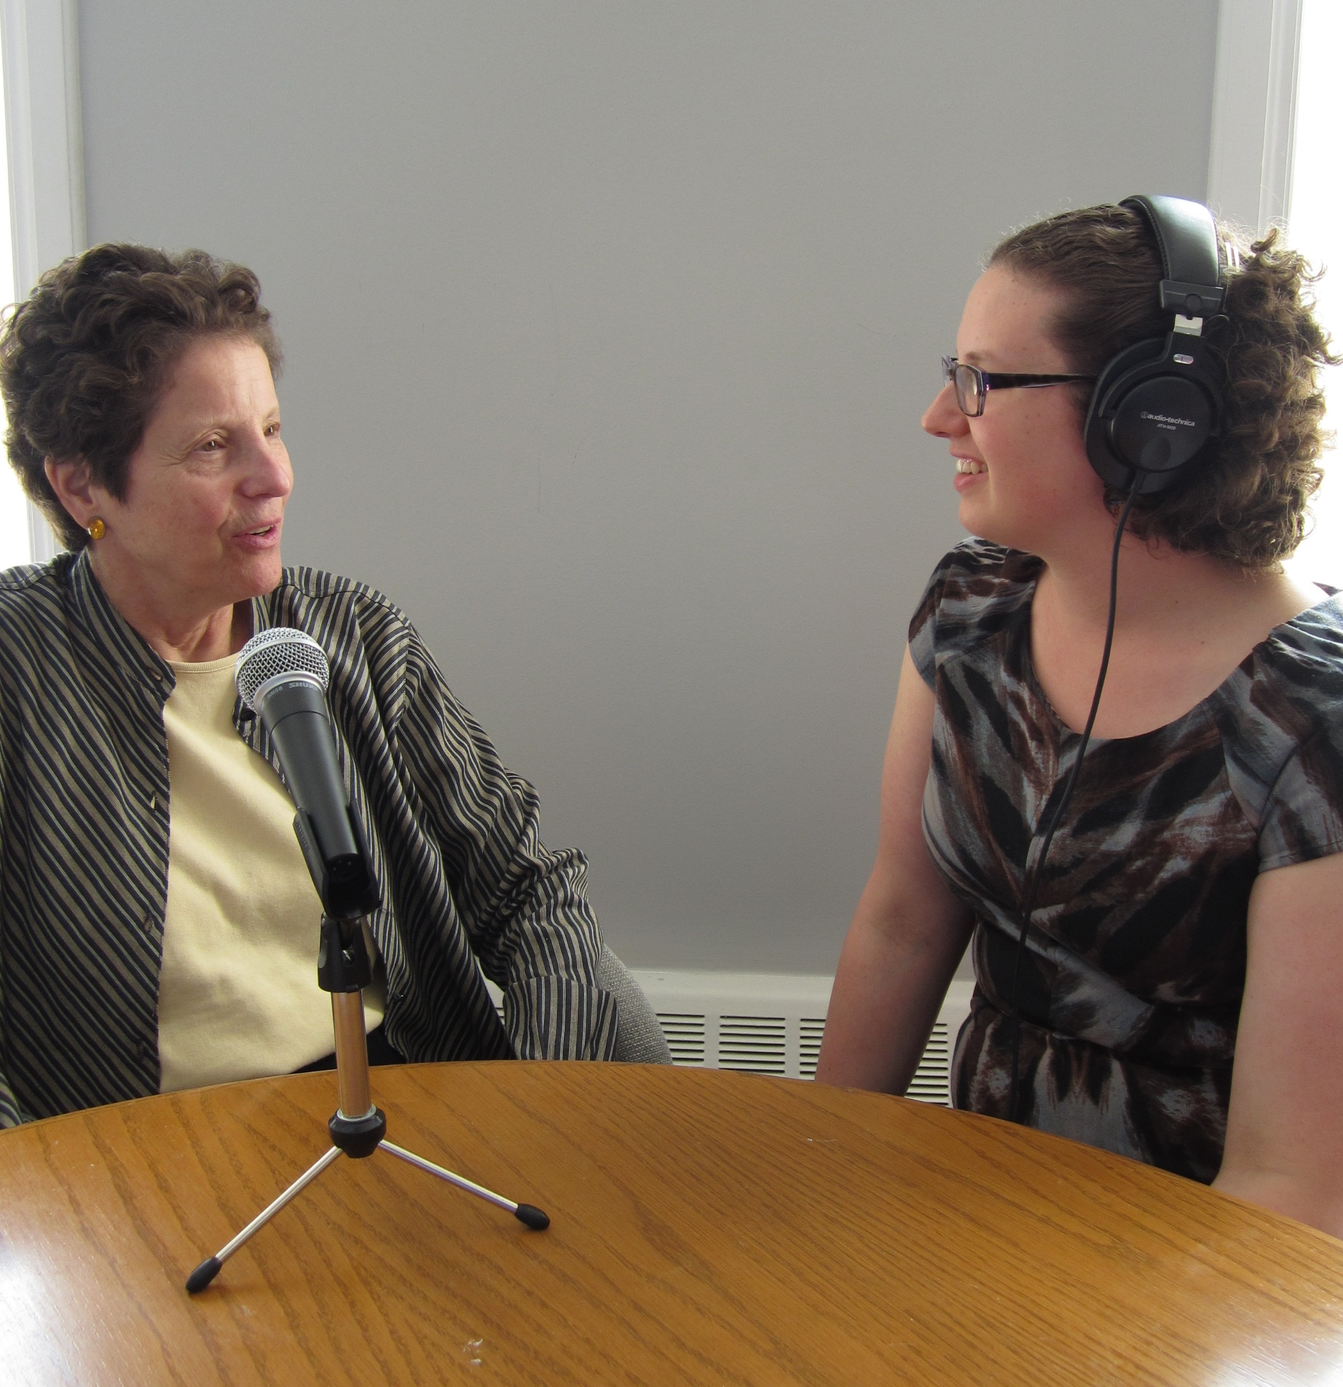
During the interview
Remember the dynamic between you as the oral historian and your research participant can change if there is someone else in the room e.g. relative.
Be mindful of the power dynamics and that your interviewee may be nervous and wonder if what they have to say is worth hearing.
Be mindful of how you dress.
Oral history requires deep listening (more on this in week 4) and potentially tiring for both you and your participant.
Keep fieldnotes to pick up on our impressions of the interview not captured in the recording.
Your interviewee may say something you do not agree with; need to record and transcribe faithfully.

Slide 47
VULNERABLE PARTICIPANTS & RESEARCH SENSITIVITIES

Slide 48
Vulnerable participants (1)
Generally considered as:
-Infants and children under the age of eighteen who are still in education or aged
sixteen if they are not in education.
-People with learning or communication difficulties or serious mental health problems
-Patients in hospital and/or individuals under the care of social services
-People in custody or on probation
-Individuals engaged in illegal activities such as drug abuse
-Persons with a condition or illness which is directly being investigated in the study
Refugees

Slide 49
Vulnerable participants (2)
It is also recognised that vulnerabilities also arise in relation to undertaking research in some social contexts or around particular issues that have affected communities or organisations and the guidelines should also apply in these situations.

Slide 50
YOUR HEALTH & WELLBEING AS AN ORAL HISTORIAN

Slide 51

Your health and wellbeing (1)
Consider your safety: make sure someone knows where you are going and when you will be coming back.
Do a ‘risk assessment’ and ‘risk assessment recce’ on the location of the recording. Avoid wearing headphones so you are aware of your surroundings. Try and travel on the daylight. Check street lighting, pavements, road crossings or other hazards.
Assess the suitability of the venue: is it safe? Can you park? How will you get to the location of the recording?
Assess the interview location. If needed, could you leave quickly?

Slide 52
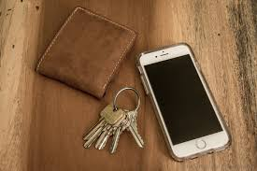
Your health and wellbeing (2)
Check your keys, wallet, phone all safely with you in the places you would expect to find them.
Use a personal safety app which has close circle e.g. Life 360. Make sure your mobile phone is fully charged. Pack a charger and an emergency portable power bank.
Make sure you are well rested the night before. Make sure you have eaten and well hydrated. Bring bottle of water. Consider mouth lozenges.
Hearing people’s memories impact on us. Pace yourself. Limited yourself to a maximum of two interviews a day. Find a trusted mentor for debriefings (principles of ethics including confidentiality applies to your mentor too).
OHNI Practical Guidelines

Slide 53
A framework for best practice
Research
Restraint
Rapport
Retreat
Review
Respect

Slide 54
Task 1 next week: project design
Your project title
Topic/purpose
Methodology
Scope, time and place.
Potential narrators.
Selected archives
Planned outcomes.
Timeframe for completion.
(One side of A4).

Slide 55
Task 2 for next week: ethics paperwork
Familiarise yourself with the documentation needed to safeguard informed consent, research integrity, data protection and assignment of copyright.

Slide 56
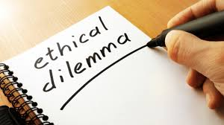
Task 3 for next week: ethical dilemmas
Your oral history interviewee begins to talk about painful memories from a childhood experience. Your interviewee is showing visible signs of being upset. What should you do?
You have been given the opportunity to post an interview recorded last year on your project web site. The interview was not recorded by you. You have heard that this interview has rich content which would shed new light on the issue you are researching. What should you do?
Your interviewee has said that they can disclose many new insights on the theme you are researching but have stipulated you would need to keep the information strictly confidential. What should you do?

Slide 57

Your student community meeting
Have a discussion on how you would like to hold your student community meetings.
There will be two in total between now and the end of the course.

Slide 58
What we have covered in today’s session
The evolution of ethics – the importance of the principles of beneficence and malfeasance and a note on knowledge creation.
Ethics in action for the oral historian: principles of informed consent and assignment of copyright; the participant information sheet; gatekeeper protocol; interviewee summary sheet & consent to use images or other materials; risk assessment;interview dynamics; incentives or bribes?
Vulnerable participants and research sensitivities.
Your health and wellbeing as an oral historian.

Slide 59
References
Largent, E. A., Eriksen, W., Barg, F. K., Greysen, S. R., & Halpern, S. D. (2022). Participants’ perspectives on payment for research participation: A qualitative study. Ethics & Human Research, 44(6), 14-22.
Duncombe, J., & Jessop, J. (2002). Doing rapport’and the ethics of ‘faking friendship’. Ethics In Qualitative Research, 2.
Russell, C. (1999). Interviewing vulnerable old people: Ethical and methodological implications of imagining our subjects. Journal of Aging Studies, 13(4), 403-417.

Slide 60
Additional resources
Oral History Association glossary of terms

