Slide 1

ORAL HISTORY MADE EASY
WEEK 2: Researching definitions of oral history
& memory as a process
Sunday 24th March 2024 14.00 hrs GMT
With DR ANGELA MAYE-Banbury BA MSc PhD SFHEA
ORAL HISTORIAN & EMERITUS FELLOW IN ORAL HISTORY

Slide 2
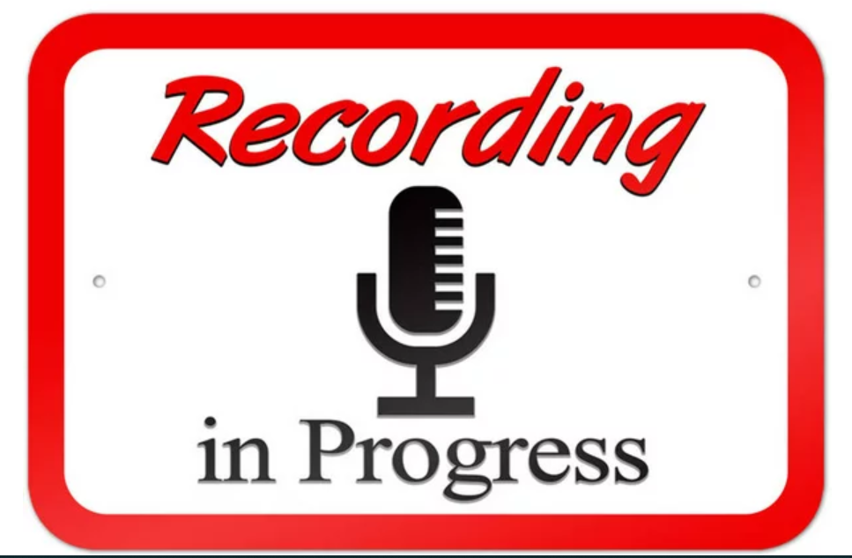

Slide 3

What we will have achieved at the end of today’s session
Your reflections on hopes and fears; experiences, beliefs and values and Linda Shopes’ paper: your ‘motivation hubs.’
The emergence of oral history and exploring definitions of oral history.
The emergence of modern day oral history practice: a note on narratives and
defining oral history.
Memory as a process: the ‘unreliable’ witness; evoking our memories; the subjectivity of oral history; individual/collective memory.
Your oral history challenges (i) Identify one resource which you think will be of valuable
to everyone; (ii) Begin to think about who you would like to interview (iii) Explore the professional organisations which support oral historians in their everyday practices.

Slide 4
YOUR REFLECTIONS ON LAST WEEK’S TASKS

Slide 5
Your reflections from last week’s tasks
Hopes and fears
(keep your notes handy)
Experiences, beliefs and values (again, keep your notes handy)
Linda Shopes’ paper – discussion in pairs.

Slide 6
Linda Shopes’ paper – your reflections
Zoom room discussion in pairs: Linda Shopes (2011) paper entitled ‘Making sense of oral history.’
Your task: What is the value of oral history, according to the author?
In your opinion, does oral history have any other benefits not mentioned in the paper?

Slide 7
THE EMERGENCE OF ORAL HISTORY & EXPLORING DEFINITIONS

Slide 8
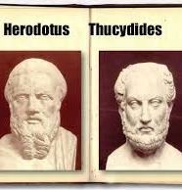
The emergence of oral history
The first ever oral historian is generally regarded to have been Thucydides (c.460 BC c 400 BC) chronicled nearly 30 years of war and tension between Athens and Sparta using eyewitness accounts.
Mention must also be given to Herodotus 425 BC whose accounts of history were infused with myth, legend and narratives of triumph.

Slide 9
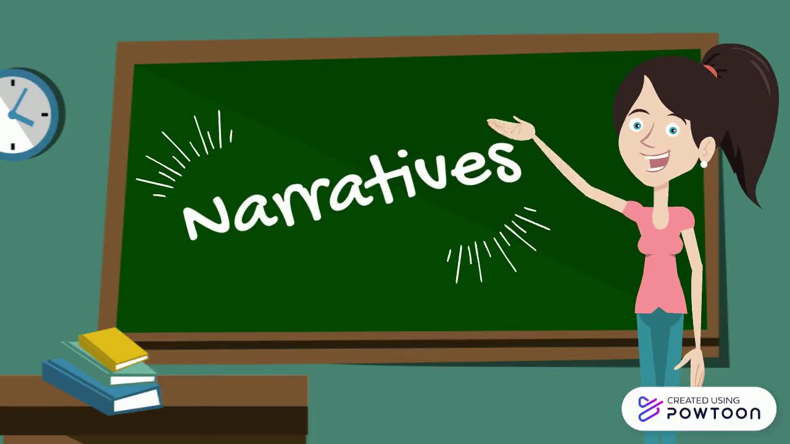
A note on narratives
We need to be always vigilant when considering how narratives are formed, by whom and why.
Meta narratives: a plot or backstory widely accepted in society presented top down in such a way as to minimise critique; associated with modernism. Even the emergence of oral history itself is often presented as a metanarrative.
Micro narratives: individual accounts such as oral histories which are generated from the bottom up recounted by those who have born witness to past events; associated with postmodernism.
And everything in between…

Slide 10
Exploring the emergence of modern day oral history practice
Allan Nevins 1948 from Columbia University began to record spoken memories of white male elites (Yow, p 3) including politicians, business and civic leaders.
Improvements of technology meant that oral history began more popular with the advent of the cassette recorder and much more besides.
Studs Terkel 1912 – 2008: saw oral history as a tool for social justice
Listen to Studs Terkel’s oral history interviews

Slide 11


Defining oral history (1)
Oral history is a people’s history; concerns events of the past recounted in an individual’s own words. Silent voices, hidden stories and personal narratives.
“The interviewing of eyewitness participants about in the events of the past for the purposes of historical reconstruction” (Grele, 1996: 63 in Thomson, 1999).
"Memory is the core of oral history. Put simply, oral history collects memories and personal commentaries of historical significance through recorded interviews" (Richie,2014: 1).

Slide 12


Defining oral history (2)
“Oral history is the recording of personal testimony derived in oral form for purposes beyond the recording itself” (Yow, 2014 p 4).
“Oral history draws on memory and testimony to gain a more complete or different understanding of a past experienced both individually and collectively” (Bornat, 2004).
The method of gathering, preserving and interpreting the voices of people, communities and participants in past events…the sharing and maintenance of stories (OHA, 2024) Watch this short film by Oklahoma Oral History project.

Slide 13
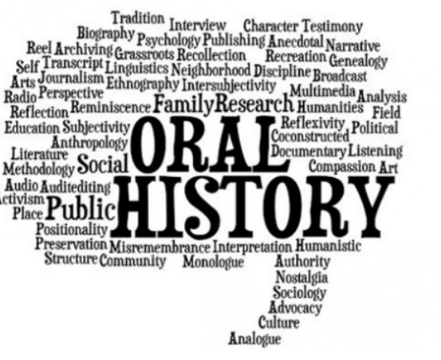
Defining oral history (3)
Oral history is: (i)the recording itself (ii)the transcript and (iii)the practice.
Interdisciplinary practice which yields rich primary data which can be applied to a diverse range of contexts.
Recordings are intended to be accessible and often kept in public repositories.
British Library Sound Archive; East Midlands Sound Archive; Columbia Centre For Oral History; Achill Oral Histories.
Professional communities of practice: Oral History Society; Oral History Network Of Ireland; Oral History Association.

Slide 14





What makes oral history different
Gives us access to undocumented rich life experience to generate ‘thick descriptions’ of past events.
Enables us to understand how experiences felt and their consequences
Allows us to have a dialogue with interviewees enabling them to assign meaning to past events.
Allows us to focus on aspects of life rarely documented
Hidden histories of people whose voices have been neglected or misrepresented to create a ‘shared authority’ (Frisch, x)
Adopted from Thomson (2009)

Slide 15

Capturing real life experiences

Slide 16
Exercise 1
In your own words, write a definition of oral history
Think of one group whose voices have been marginalised from accounts of the past.
How MIGHT ORAL HISTORY MAKE THIS GROUP’s STORY MORE ACCESSIBLE?

Slide 17
MEMORY AS A PROCESS
THE ‘UNRELIABLE’ WITNESS & EMBRACING SUBJECTIVITY

Slide 18
Key issues – oral history and memory
With verbatim records of our experiences, we are unable to report on those experiences faithfully. Without recording, each iteration of the story will shift.
In an oral history interview, people seldom recount their experiences chronologically – and in a moment, we shall see why. What is the relevance of the tangents?
Our inability to remember our lives aged between – 3 (approx) and our limited recollections of past experiences until we are around 10 years old is called ‘infantile amnesia’ and is attributed to evolving neurological development in the early years of our lives (Callaghan et al, 2014).

Slide 19
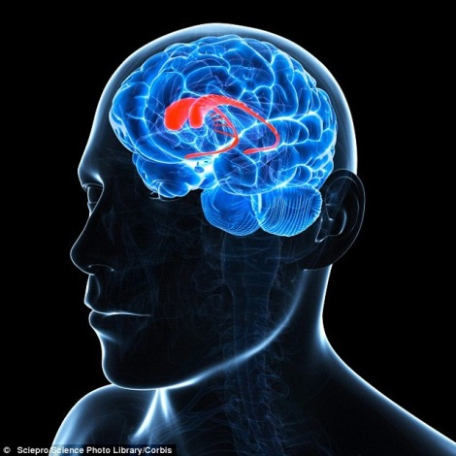
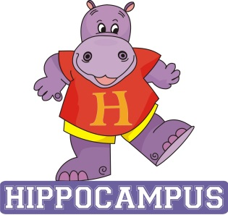
The mechanics of memory
Hippocampus: long term memory; strong; emotional.
Visual stimuli: pictures more 'memorable' than words.
Sensory stimuli.
Marilee Sprenger's work on memory:
"The brain is programmed to forget, it filters out about 99 percent of incoming information. This usually allows us to focus and keep our sanity."
Prefrontal cortex: short term memory.
Tales around 7 repetitions for something to go from short to long term memory.

Slide 20
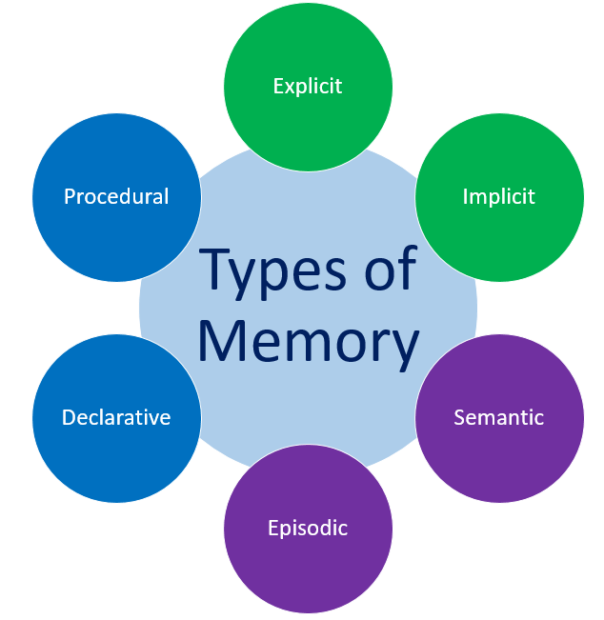
Implicit - remembering things subconsciously by rote e.g. knowing the route to home or work
Explicit - consciously remembering things e.g. appointments.
Procedural - remembering how to perform a task or skill e.g. riding a bike; using software.
Declarative - remembering facts; faces; phone numbers.
Episodic - remembering recall of personal experiences at specific moment.
Semantic e.g. recalling facts triggered by words/phrases.
SENSORY MEMORY – THE ‘PROUSTIAN RUSH’

Slide 21
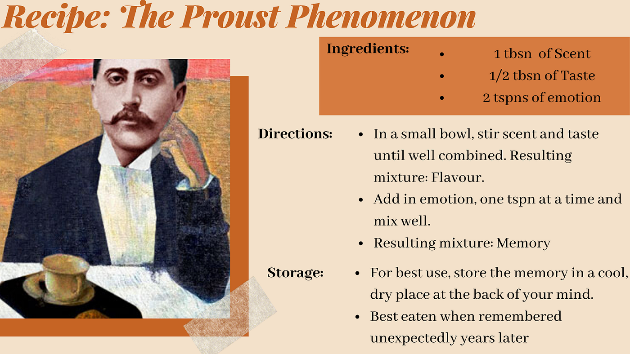
Exercise 2: What scent/aroma gives you a Proustian rush?

Slide 22
Strategies to improve our memories
Stories | Stories have emotional components that attract the amygdale, the emotional centre of the brain. They also have beginnings, middles, and ends that make sense to the hippocampus, the structure that helps store these episodes.
Humour | Humour, laughter, and joyfulness release important brain chemicals that make us feel good and aid in retention. Some research suggests that we remember at least 30 percent more of what we learn with humour.
Games | Learning through play is one of the most powerful ways to learn. Limiting competition is important.
Analogy | Creating assists brains in connecting new information to what it is being compared to.
Metaphor | Oral History Made Easy is like a delicious buffet of tasty knowledge.
Movement | Active, hands-on learning will bring back memories of prior movement and movement patterns

Slide 23

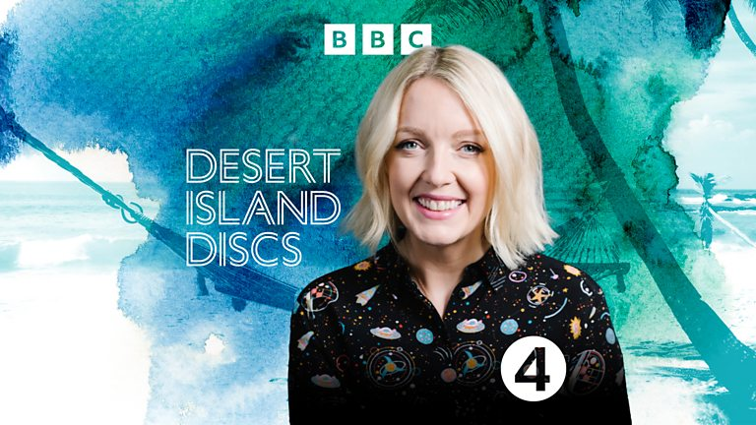
Exercise 3: Musical memory moments
Soundtracks of our lives.
Choose a song that evokes particular memories for you.
BBC’s Desert Island Discs Series
Eight tracks, a book and a luxury: what would you take to a desert island?

Slide 24
Narrators as ‘unreliable’ witnesses
Oral histories are coded, decoded and recoded at multiple points.
Oral histories contains insights framed by context, layers of time and experience of the narrator. It is how people remember from a ‘web of meaning’(Abrams, 2014, p 89).
“What is really important to remember is that memory is not a passive depository of facts but an active process in the creation of meanings” (Portelli, 2002).

Slide 25
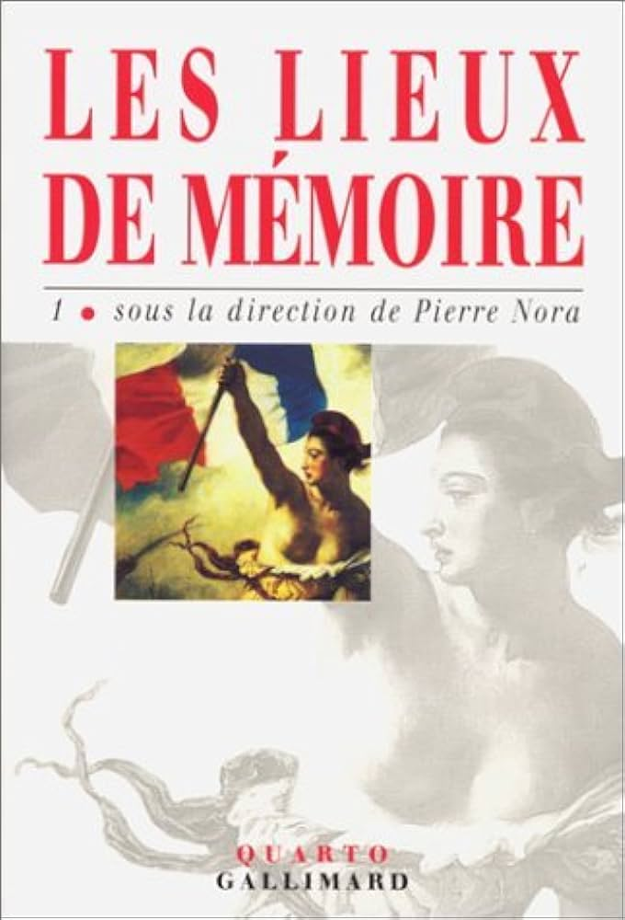
Fallibility of human memory
The role of memorials: purpose and prospects.
Sites of memory may be:
- Physical
- Digital
- Imagined.
Pierre Nora & sites of memory.

Slide 26
Embracing (& interrogating) subjectivity
Importance of habitus.
“One precise advantage of oral evidence is that it is interactive and that one is not left alone, as with documentary evidence, to divine its significance. The source can reflect on the content and offer interpretation as well as facts” (Lummis, 1988).
“The importance of oral testimony may often lie in not in its adherence to facts but rather in its divergence from them where imagination, symbolism and desire break in.” (Portelli, 2002).

Slide 27
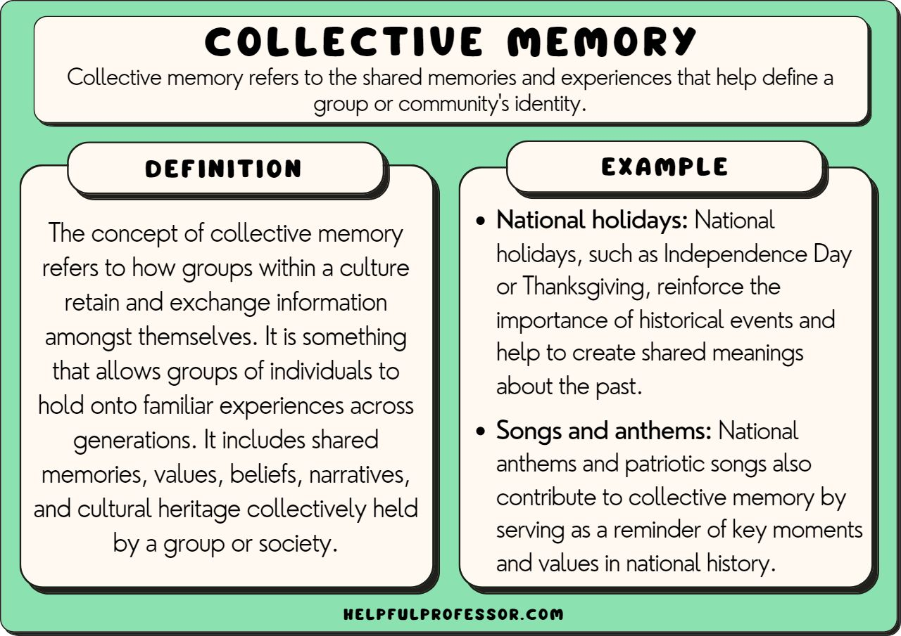
Individual & collective memory

Slide 28
YOUR MOTIVATION HUBS

Slide 29
Motivation peer support hubs
Meet at least twice outside like sessions: weeks 3 and 5.
Deciding on who will be in each hub; discuss practicalities.
Three volunteers to co-ordinate the three motivation hubs.

Slide 30
Your one to one mentorship sessions
AMB to be in next week touch to arrange your 30 mins one to ones.

Slide 31
Tasks for week 3
Your oral history challenges for next week!
1.Find one oral history resource you like and think could be useful to the group. This can be in any format! Please email your resource to Angela for sharing with the group on or before 28th March 2024.
2. Begin to think about who you would like to record for your first oral history interviewee.
3. Explore professional communities of practice: Oral History Society; Oral History Network Of Ireland; Oral History Association. What are your three key takeaways following your the review of these web sites?

Slide 32
What we have achieved at the end of today’s session
Your reflections on hopes and fears; experiences, beliefs and values and Linda Shopes’ paper: your ‘motivation hubs.’
The emergence of oral history and exploring definitions of oral history.
The emergence of modern day oral history practice: a note on narratives and
defining oral history.
Memory as a process: the ‘unreliable’ witness; evoking our memories; the subjectivity of oral history; individual/collective memory.
Your oral history challenges (i) Identify one resource which you think will be of valuable
to everyone; (ii) Begin to think about who you would like to interview (iii) Explore the professional organisations which support oral historians in their everyday practices.

Slide 33


Slide 34
References
Abrams, L. (2014). Memory as both source and subject of study: The transformations of oral history. Writing the history of memory, 89-109.
Bornat, J. (2004) ‘Oral history’ Qualitative Research Practice, 34-47.
Callaghan, B. L., Li, S., & Richardson, R. (2014). The elusive engram: what can infantile amnesia tell us about memory?. Trends in neurosciences, 37(1), 47-53.
Grele [1973] 1996, 63) in Thomson A. ‘Making the Most of Memories: The Empirical and Subjective Value of Oral History,’ Transactions of the Royal Historical Society. 1999;9:291-301. doi:10.2307/3679406.
.

Slide 35
References (contd)
Lummis, T. (1988). Listening To History: The Authenticity Of Oral Evidence. Rowman & Littlefield.
Portelli, A. (2002). What makes oral history different. In The oral history reader (pp. 77-88). Routledge.
Ritchie, D. A. (2014). Doing Oral History. Oxford: Oxford University Press.
Turnbull, O., & Solms, M. (2004). Memory, amnesia and intuition: a neuro-psychoanalytic perspective. In Emotional development in psychoanalysis, attachment theory and neuroscience (pp. 63-92). Routledge.
Yow, V. R. (2014). Recording Oral History: A Guide For The Humanities And Social Sciences. Rowman & Littlefield.

Slide 36
Additional resources
Introduction To Oral History – Texas Digital Library
Development And The Use Of Oral History

