Slide 1

ORAL HISTORY MADE EASY
WEEK 4: Getting ready for your first oral history interview
Sunday 11th August 2024 14.00 hrs GMT
With DR ANGELA MAYE-Banbury BA MSc PhD SFHEA
ORAL HISTORIAN & EMERITUS FELLOW IN ORAL HISTORY

Slide 2
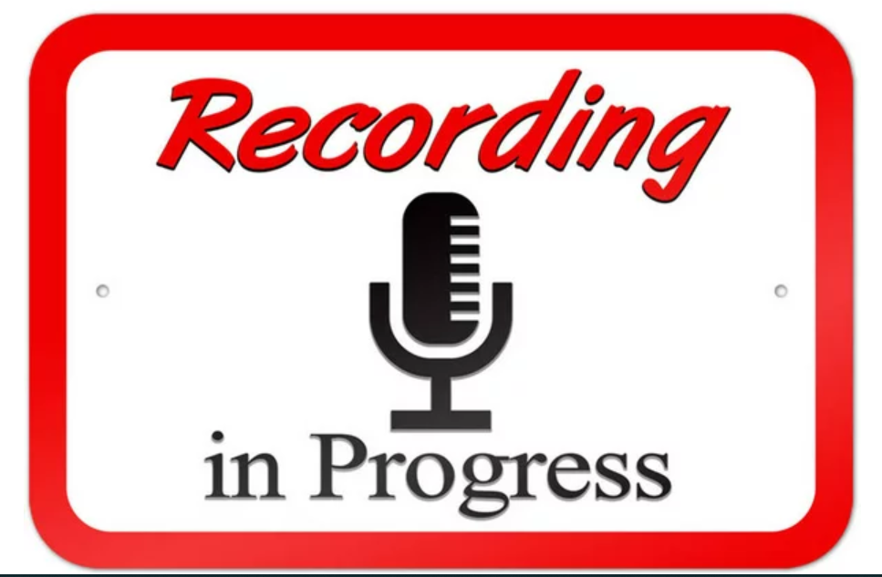

Slide 3


Slide 4


Slide 5

You’ve done the heavy lifting! Now for the joyous part!

Slide 6

What we will have achieved at the end of today’s session
Recap on ethics documentation and one thing you’ve learnt so far on the course.
Feedback from last week’s ethical dilemmas and project proposal.
Golden rules for conducting your first oral history interview; preparing; on arrival;
question types and the art of listening.
After the interview and guidance on transcription.
The assignment

Slide 7
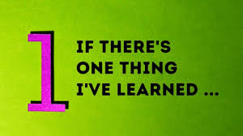

Slide 8
YOUR FEEDBACK ON LAST WEEK’S TASKS

Slide 9

Task 1:Ethical dilemmas.
Your oral history interviewee begins to talk about painful memories from a childhood experience. Your interviewee is showing visible signs of being upset. What should you do?
You have been given the opportunity to post an interview recorded last year on your project web site. The interview was not recorded by you. You have heard that this interview has rich content which would shed new light on the issue you are researching. What should you do?
Your interviewee has said that they can disclose many new insights on the theme you are researching but you would need to keep the information strictly confidential. What should you do?

Slide 10

Task 2: Project design
Your project title
Topic/purpose
Methodology
Scope, time and place.
Potential narrators.
Selected archives
Planned outcomes.
Timeframe for completion.

Slide 11
RECAP ON ETHICS PAPERWORK

Slide 12
Reminder of the ethics documentation you will need
The participant information sheet
The gatekeeper protocol (if needed)
Agreement to participate
Recording agreement (signed after the interview).
Consent to use images (if needed)
Exemplars USA and Ireland

Slide 13

Habitus: Oral historian mindset. Ethics as starting point. Do risk assessment.
Identify participant/gatekeeper organisation. Verify non vulnerable interviewee.
Make contact with participant. Ensure transparency and build trust/rapport.
Go through participant sheet. Answer all questions . Secure consent to participate.
Conduct interview. Complete written deed of gift (USA) or recording/copyright agreement (Ireland/UK) after interview. Obtain written consent to use images
Explain next steps to interviewee including verification of transcript and making available. Follow through.
ORAL HISTORY AND ETHICS FLOW CHART
YOUR FIRST INTERVIEW

Slide 14
Highly recommended viewing
Doug Boyd Oral History, Ethics and AI - Seminar Presentations

Slide 15
The assignment (1)
Learning outcomes:
This assignment has the following three learning outcomes:
(i) To apply the principles of experiential learning to the practice of oral history.
(ii) To allow for reflection on the knowledge, skills and attributes needed in oral history.
(iii) To inform a professional and personal action plan as part of ongoing self development.
Due 1st September 2024.

Slide 16
The assignment (2)
Choose from one only:
(i) A 1,000 word written report with 750 words on your development journey and the remaining 250 on your future development action plan OR
(ii) Poster series using four Power Point slides which show your oral history development journey (three slides) and your future development action plan (one slide). You can add a narration here if you want (optional) OR
(iii) A short film lasting around 6 – 8 minutes where you talk about your oral history development journey (4 – 5 mins) and your professional development plan (2 – 3 mins) OR
(iv) An audio file or short podcast lasting around 6 – 8 minutes where you talk about your oral history development journey (4 – 5 mins) and your professional development plan (2 – 3 mins) OR
(v) Other format e.g. collage; poem; web based resource; other. Please check the suitability of your format with Angela before proceeding.

Slide 17
The assignment (3)
Choose from one only:
(i) A 1,000 word written report with 750 words on your development journey and the remaining 250 on your future development action plan.
(ii) Poster series using four Power Point slides which show your oral history development journey (three slides) and your future development action plan (one slide). You can add a narration here if you want (optional)
(iii) A short film lasting around 6 – 8 minutes where you talk about your oral history development journey (4 – 5 mins) and your professional development plan (2 – 3 mins).
(iv) An audio file or short podcast lasting around 6 – 8 minutes where you talk about your oral history development journey (4 – 5 mins) and your professional development plan (2 – 3 mins).
(v) Other format e.g. collage; poem; web based resource; other. Please check the suitability of your format with Angela before proceeding.

Slide 18
GOLDEN RULES FOR INTERVIEWS & THE ART OF LISTENING

Slide 19

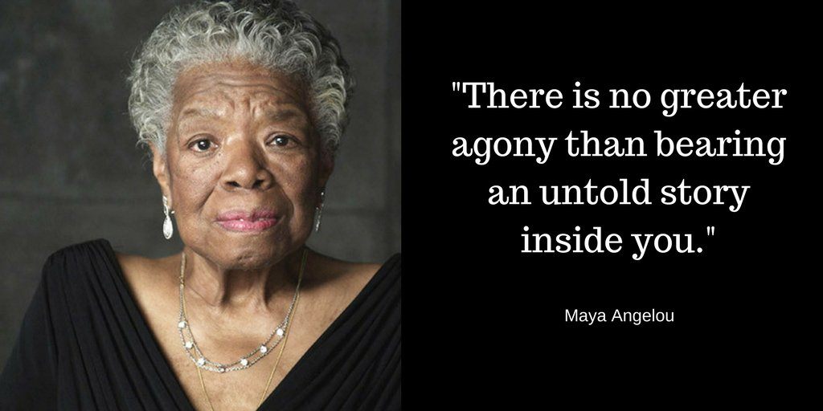
The oral history interview has two heroes: you the interviewer and your interviewee.

Slide 20

Golden rules for interviews (1)
Negotiate
Ensure you have been transparent about the scope of your project. Negotiate a time/date and venue. Confirm in email at least twice and phone on the day and/or day before. Book in at least two hours per interview.
Ensure
Ensure the consent form pre signed, the copyright/recording or deed of gift form prepared pre-populated with your interviewee's details for signing after interview. Send at least one week in advance of your interview. Check with your interviewee you have access to a quiet location.
Check
A few days before, check your equipment (battery levels) and make sure you have a contingency recorder in place (equipment covered separately). Test equipment. Make sure you are very familiar with the equipment. Check equipment the morning and the day before.
Visit
Visit location of interview a few days before. Check for extraneous noise. Mobile phones fully charged and on silent. Be aware of your personal safety – risk assessment.
Pilot
Do your pilot/test interview. What three things went well? What would you do differently next time? Apply the principles of experiential learning (see week 1).

Slide 21
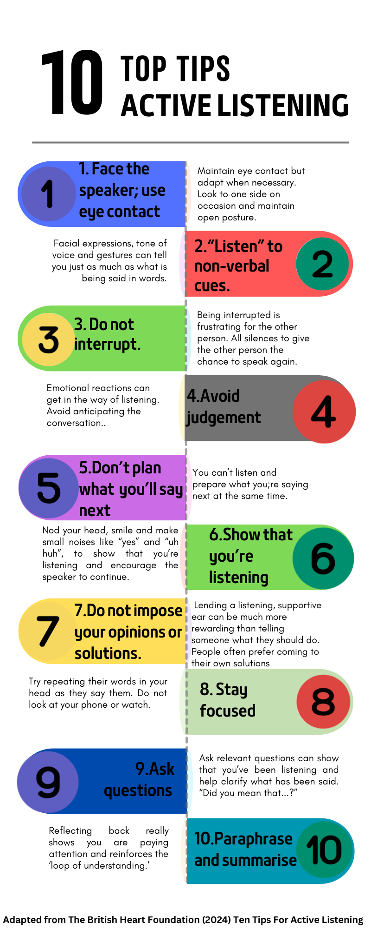
The art of listening
The art of listening and reflections on the listening challenge.
Amend depending on context – use your judgement..
Top ten listening tips (VLE).

Slide 22
What equipment you will need on the day (1)
Recording equipment which saves to .wav format and had ideally with two external mics (Zoom) and USB port. Zoom online also works well with basis safeguards in place. H2N Handy Zoom recorder.
Back up or alternative recording device e.g. IPad or smart phone; dictaphone or other digital recording device. Check you have enough memory (memory cards) Make sure you can get your recording off your equipment.
Editing software e.g. Wavelab; Audacity.
External mic and stand; rubber pad for recorder (a mouse pad or book works well).
Headphones to check sound levels.
Batteries (inc spare) and power supply.

Slide 23
What equipment you will need on the day (2)
Note pad and pens.
Mobile phone and charger (on silent).
Your list of questions – try and memorise your key themes so you can focus on your interviewee.
Any visual prompts such as photographic materials.
Bottle of water.
Throat lozenges e.g. Vocalzone or Fishermen's Friends.
Remember your own health and well being.

Slide 24
Your recording equipment
Practise using your recording equipment until you are highly competent at setting up, recording, downloading and editing your interviews.
Standard recorders for oral history (archival quality) are: Zoom H1; Tascam DR-05; Zoom H2n (my favourite); Zoom H4n; Tascam DR-40; Zoom H5; Zoom H6; Roland R-26 and Tascam DR100 mk1.
See https://le.ac.uk/emoha/how-to-do-oral-history/equipment/sound-recorders

Slide 25

Preparing your questions
Oral history interviews are a dialogue and therefore should be a natural exchange. But as a 'conversation with a purpose,' you will need a set of questions.
Research your oral history topic. Use Google Scholar to guide you towards peer reviewed research.
Create a topic guide which will act as a road map for you and your interviewee. Be prepared to improvise when needed.
Use open ended questions. Tell me about your first memory of…Describe the place you lived in when…What was that like? Why do you think…?

Slide 26
On arrival at the interview location
Remember the insights from your pilot. This will help your confidence as an interviewer. It will also enable you to check the flow of your questions.
Make a good positive impression. Ensure you arrive on time, greet your interviewee warmly and thank them for participating.
Before the interview formally begins, switch on the recording equipment and ask a benign question to check sound levels e.g. Tell me what you had for breakfast.
Have your back up recorder switched on as well.

Slide 27
Documenting time and place of interview.
It's good practice to capture the date, time and location of your interview on your recording.
A suggested opening statement is: "My name is (name of interviewer) and I am here with (name of interviewee) on (date & year) at (venue). (Name of interviewee), thank you so much for taking part in this interview. Can I confirm, please that you have read the participant information sheet? (wait answer). Can I now go through the consent form with you? (tick boxes in person or virtually).”
Avoid too much formality. People often prefer more inviting vocabulary e.g. share your story; talk about memories of…

Slide 28
Oral history question types
Help me understand e.g. Describe to me…Tell me…How did you feel about?...How did that come about?...What happened next?
Structural/paradigmatic questions e.g. Out of all the things you’ve said, what is the most important to you?... Can you talk me through a typical day? …What are you most proud of…?
Follow-up/clarifying questions e.g. You mentioned that…can you tell me a little bit more about that? When you said (x), can you expand a little on that?
Experience/example questions e.g. In your experience, tell me what the most challenging circumstance was that…
Comparison/contrast questions e.g. If you were to compare life before and after (x), what are the main differences?
Ending the interview e.g. What would like to see happen in the future?
Adapted from: Janesick (2014)

Slide 29


The art of active listening
The importance of the interviewer's and interviewee's "inner voices" (Roberts, 2020) in non judgmental way.
Minimal interviewer interruptions: be comfortable with silences
Enables interviewer to ask more appropriate questions; indicates to respondent that you have been listening.
The art of "hearing data" (Rubin and Rubin, 2011).
Audit interview transcripts; look at proportion of interviewer and interviewee speaking.
Actively listen; avoid thinking of quality of final recording.

Slide 30
The loop of understanding: words, emotions and feeling
Communicate
Observe
Check
Understand

Slide 31
A note on tangents
People do not recount their memories in a linear fashion. Rather, the memory is more of a labyrinth taking the narrator on a complex and nuanced route to the past.
Consequently, people will go off on what appear to be tangents. These tangents are an essential part of someone’s past and can prove highly instructive.
To move someone back to the core topic, summarise what they have said (use loop of understanding) then use an open ended question to shift emphasis.

Slide 32
AFTER THE INTERVIEW

Slide 33
After the interview
Immediately afterwards, explain the interview will be transcribed. Give timescale e.g. minimum 4 – 6 weeks. Manage expectations.
Have interview transcribed. Use line numbers and highlighted text to identify specific words/phrases which you need them to clarify.
Go through the interview with your respondents. Be mindful of any special needs. NB All interviews need to be verified by your respondent before being disseminated.
Write to your participant and thank them outlining what will happen next.
Download your interview. Make a minimum of two copies. Keep one copy on cloud based password protected storage and another on password protected hard drive.
1
2
3
4
5

Slide 34
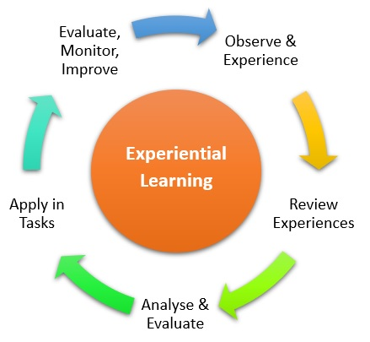
Make notes immediately after the interview
Using the principles of reflective practice, audit how you are feeling immediately after the interview.
What three things went well? What three things would you do differently next time? These reflections will be very useful for your assignment.

Slide 35
Transcribing the interview
The gold standard is the verbatim transcript verified by your narrator.
Using third party software has serious ethical implications e.g. third party ownership; copyright issues.
Moreover, no software is as effective as transcribing by a person.
Factor in 15 mins transcription time for 60 seconds of audio. Using the ‘Transcribe' tool on Word can help to speed up transcription.
Double space text.
Time code.
Send to interviewee for final sign off, checking how s/he would like to be named when published and to verify any unusual spellings in the interview itself.
See www.achilloralhistories.com and Peter Masterson Transcript July 2023

Slide 36
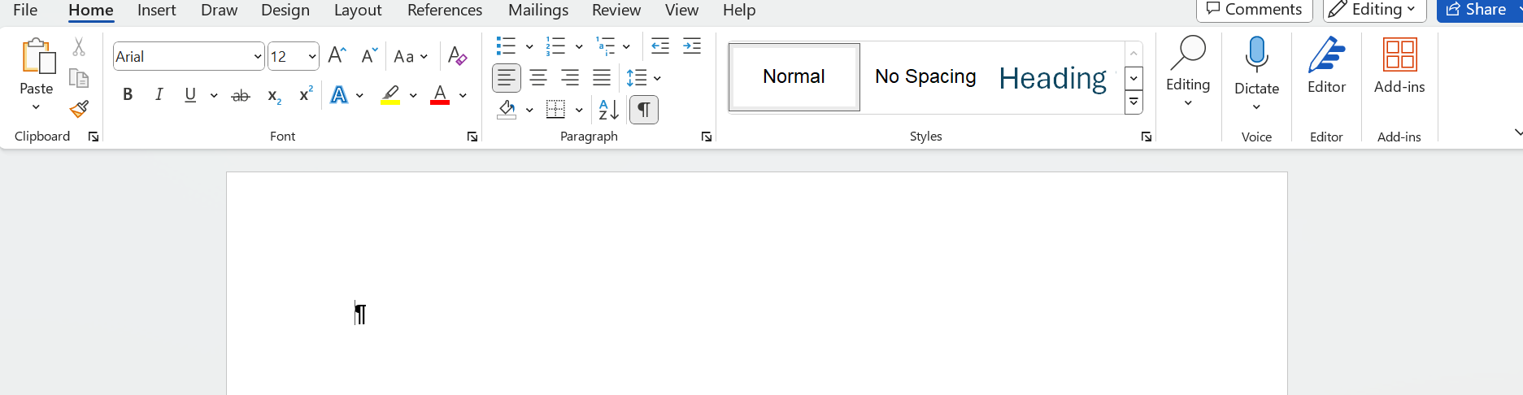
Using Word’s ‘Transcribe’ tool

Slide 37

Using the ‘Transcribe’ tool in Word (1)
Stuart reads from the Shopes paper
Angela reads from the Shopes paper

Slide 39
Archiving and storage
“Every effort should be made to ensure oral history materials are adequately stored, processed, maintained, and made accessible according to archival standards and best practices” (Oral History Association, 2022).
Make the interviews discoverable i.e search engine optimisation.
Record in .wav format (can be converted to MP3).
Upload onto web archive.
Ask for library cataloguing or other public archive.

Slide 40

The assignment (1)
This assignment has the following three learning outcomes:
(i) To apply the principles of experiential learning to the practice of oral history.
(ii) To allow for reflection on the knowledge, skills and attributes needed in oral history.
(iii) To inform a professional and personal action plan as part of ongoing self development.

Slide 41

The assignment (2)
A 1,000 word written report or equivalent with 750 words on your development journey and the remaining 250 on your future development action plan.
Alternative formats: 4 Power Point slides; short film (6 – 8 mins);audio/podcast (6 – 8 mins)or web based resource. For other formats, check with Angela. Due on or before 14.00 hrs Sunday 1st Sept 2024.
Estimated time to complete 2.5 – 3 hours. See assignment brief on the student portal.

Slide 42

Your one task between now & 25th August 2024: your pilot interview.

Slide 43
What we have covered in today’s session
Recap on ethics documentation and one thing you’ve learnt so far on the course.
Feedback from last week’s ethical dilemmas (Zoom rooms).
Golden rules for conducting your first oral history interview; preparing; on arrival;
question types and the art of listening.
After the interview and guidance on transcription.
The asssignment

Slide 44
References
Janesick, V. J. (2014). Oral history interviewing: Issues and possibilities. The Oxford Handbook of Qualitative Research, 300-314.
Roberts, R. E. (2020). Qualitative Interview Questions: Guidance for Novice Researchers. Qualitative Report, 25(9).
Rubin, H. J., & Rubin, I. S. (2012). Qualitative interviewing: The art of hearing data (3rd ed.). Los Angeles, CA: Sage. ISBN: 978-1-4129-7837-8

