Slide 1

ORAL HISTORY MADE EASY
WEEK 5:ORGANISE & CURATE YOUR FIRST ORAL HISTORY COLLECTION
With DR ANGELA MAYE-Banbury BA MSc PhD SFHEA
ORAL HISTORIAN & EMERITUS FELLOW IN ORAL HISTORY

Slide 2
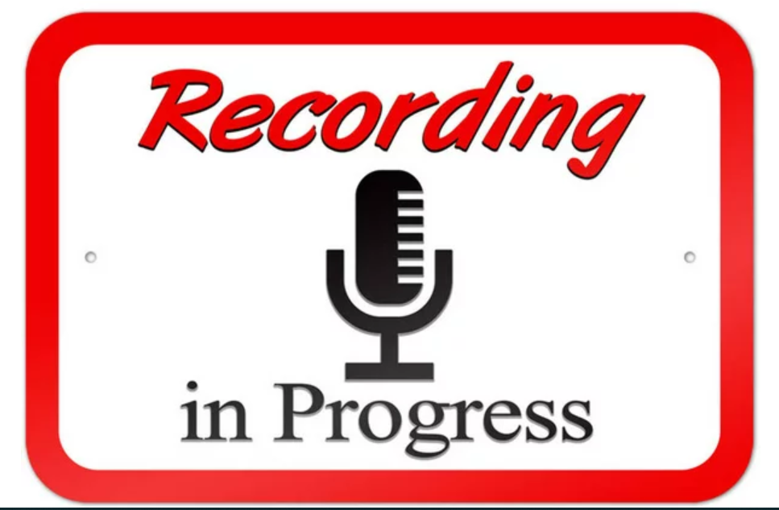

Slide 3

Overview
Review and reflection after your first oral history interview: three things that went well, three things you do differently next time.
Transcription including verification, timecoding and cataloguing.
Reviewing for sensitivities: third party references, defamation and risk.
Using sound editing software: Audacity.
Managing your archive and/or placing your recordings in a public archive.
The assignment.
Celebrating your success: next week and beyond.

Slide 4
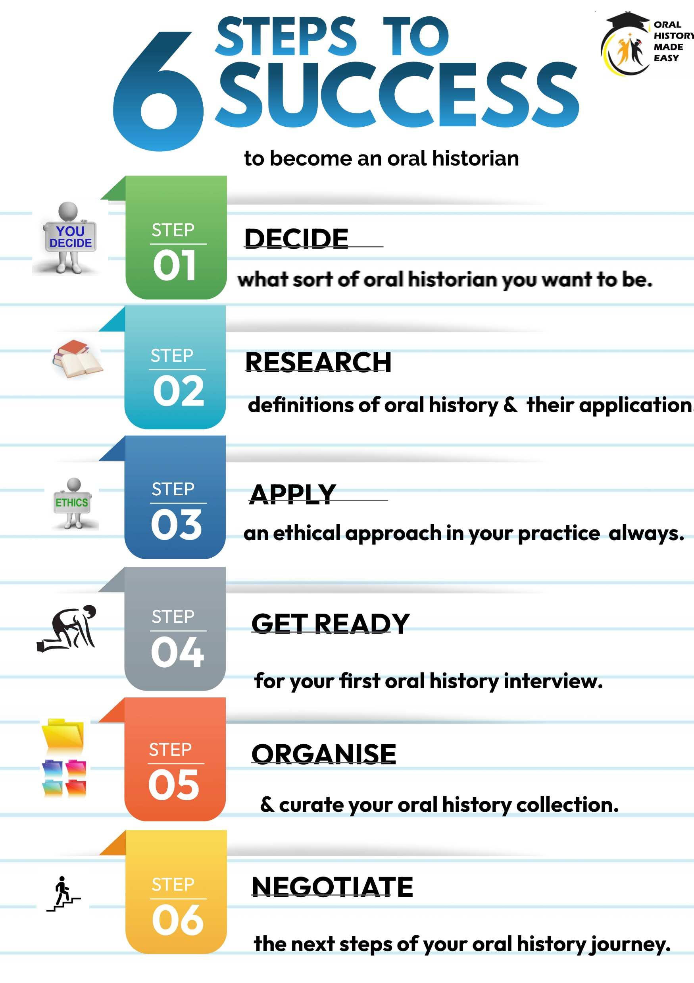
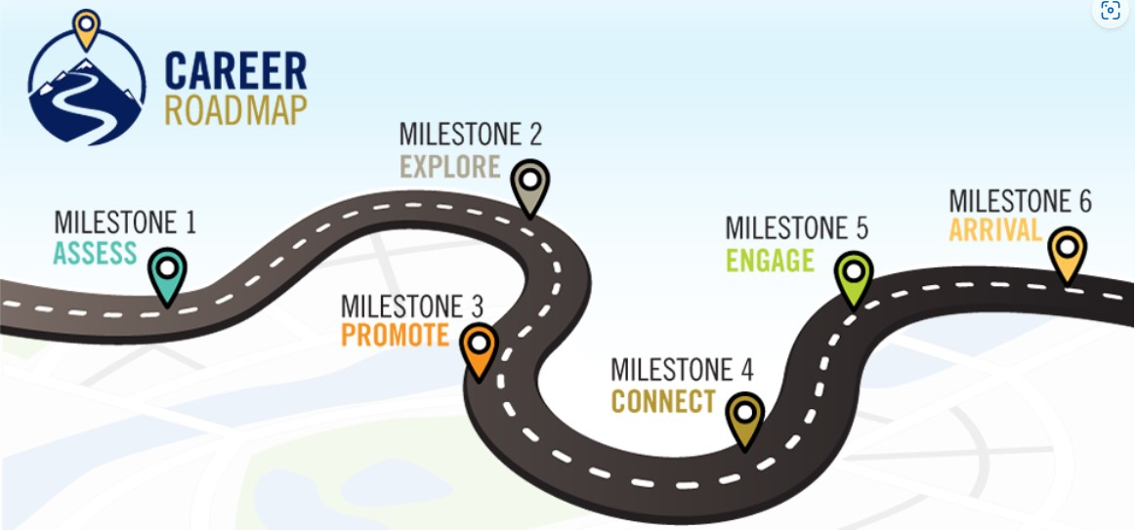

YOUR ORAL HISTORY JOURNEY

Slide 5
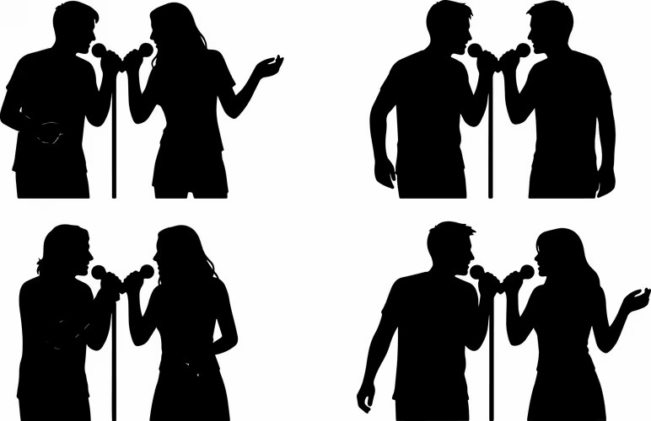
Exercise 1: Who would you most like to sing a duet with?

Slide 6
REVIEW & REFLECTION AFTER YOUR FIRST ORAL HISTORY INTERVIEW

Slide 7
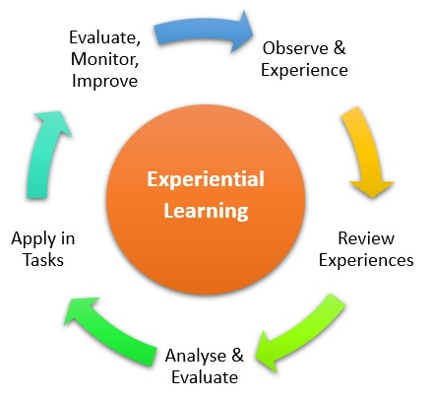
Personal reflection for deeper learning
Using the principles of reflective practice, note how you are felt immediately after the interview.
What three things went well? What three things would you do differently next time? These reflections will be very useful for your assignment.

Slide 8
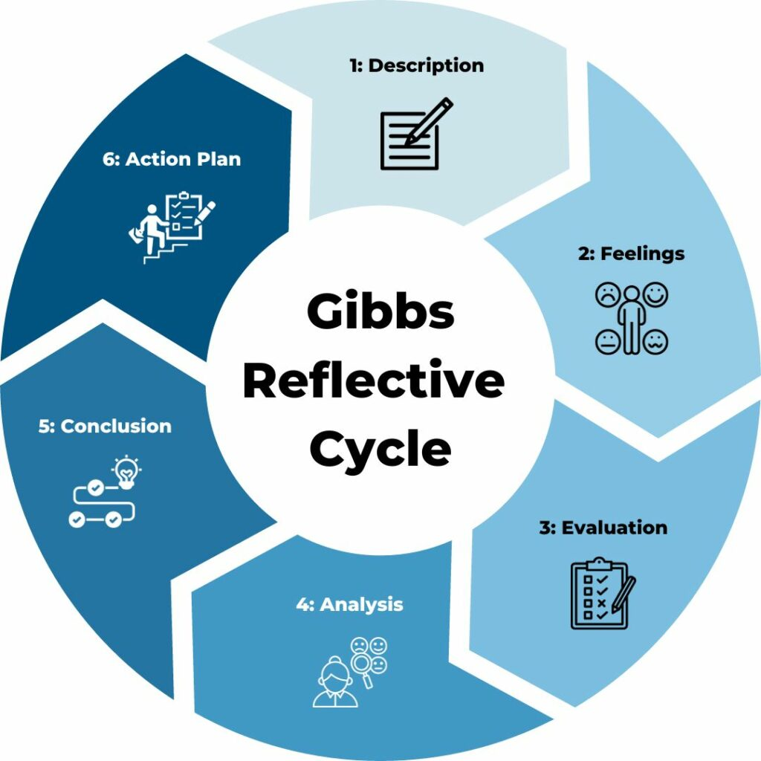
Your reflections on your oral history interview (2)
What three things might you do differently next time?

Slide 9

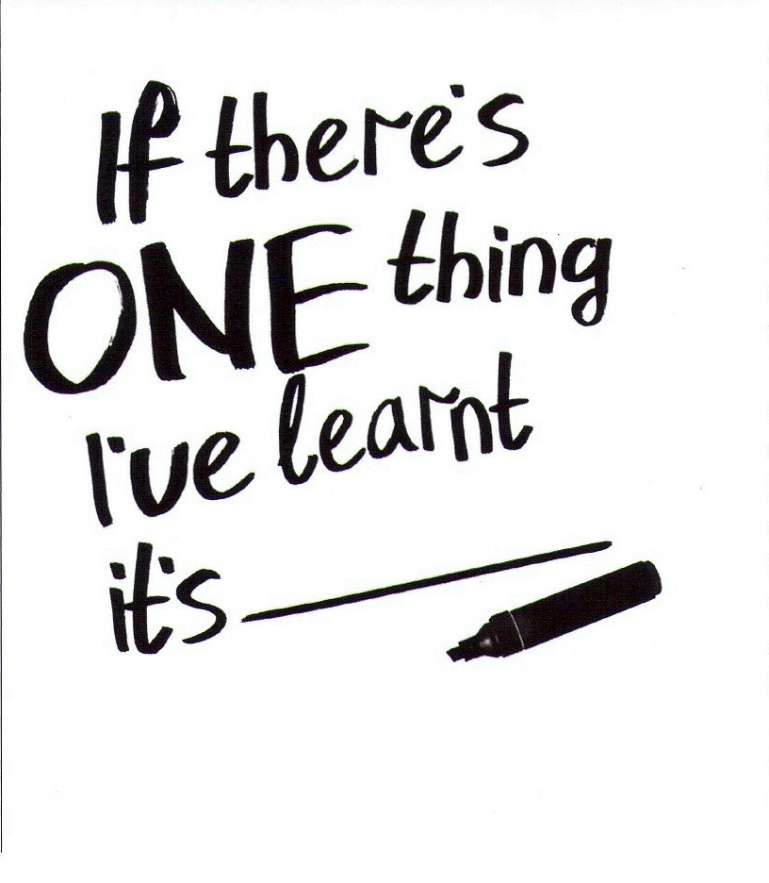
Exercise 2: One minute per student

Slide 10
AFTER THE INTERVIEW

Slide 11
After the interview
Immediately afterwards, explain the interview will be transcribed. Give timescale e.g. minimum 4 – 6 weeks. Manage expectations.
Have interview transcribed. Use line numbers and highlighted text to identify specific words/phrases which you need them to clarify.
Go through the interview with your respondents. Be mindful of any special needs. NB All interviews need to be verified by your respondent before being disseminated.
Write to your participant and thank them outlining what will happen next.
Download your interview. Make a minimum of two copies. Keep one copy on cloud based password protected storage and another on password protected hard drive.
1
2
3
4
5

Slide 12
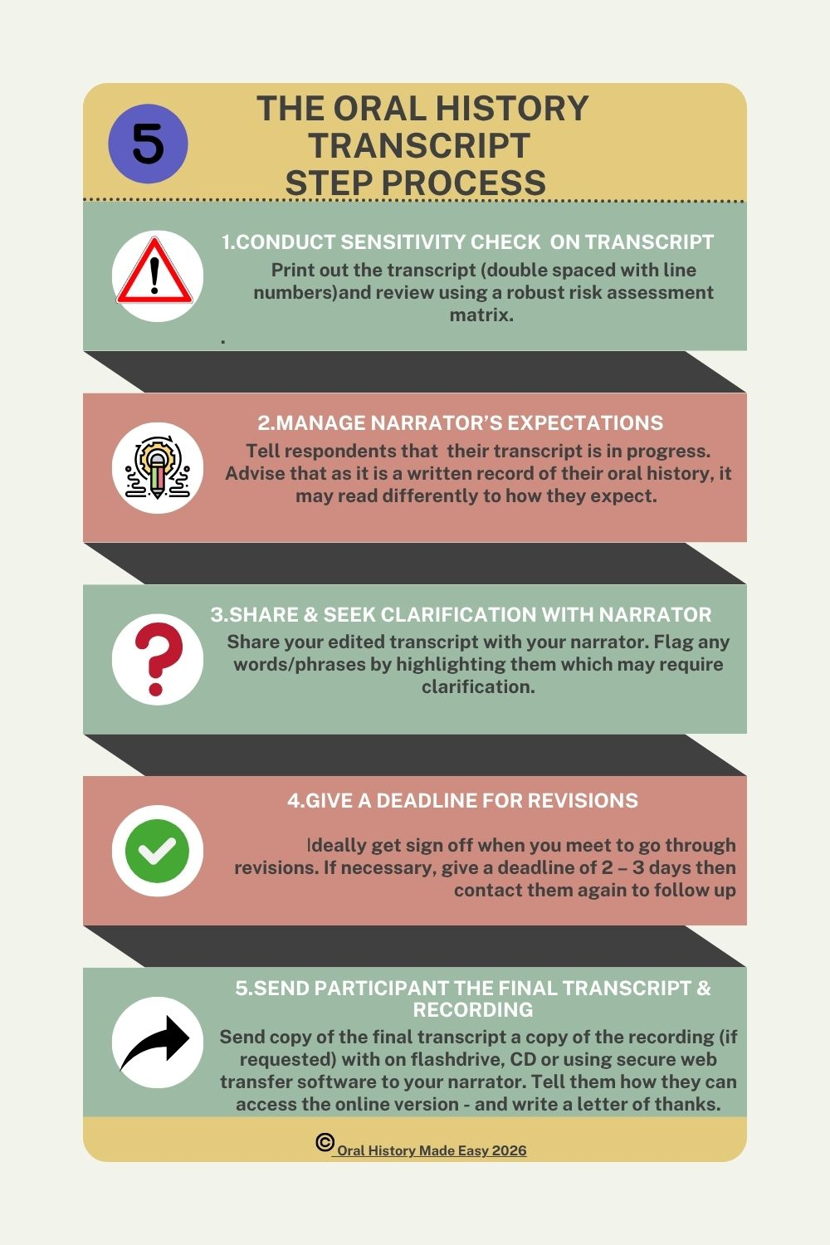

Slide 13
Transcribing the interview
The gold standard is the verbatim transcript verified by your narrator.
Using third party software has serious ethical implications e.g. third party ownership; copyright issues.
Moreover, no software is as effective as transcribing by a person.
Factor in 15 mins transcription time for 60 seconds of audio. Using the ‘Transcribe' tool on Word can help to speed up transcription.
Double space text and insert line numbers.
Add time codes.
Send to interviewee for final sign off, checking how s/he would like to be named when published and to verify any unusual spellings in the interview itself.
See www.achilloralhistories.com and Peter Masterson interview and transcript

Slide 14
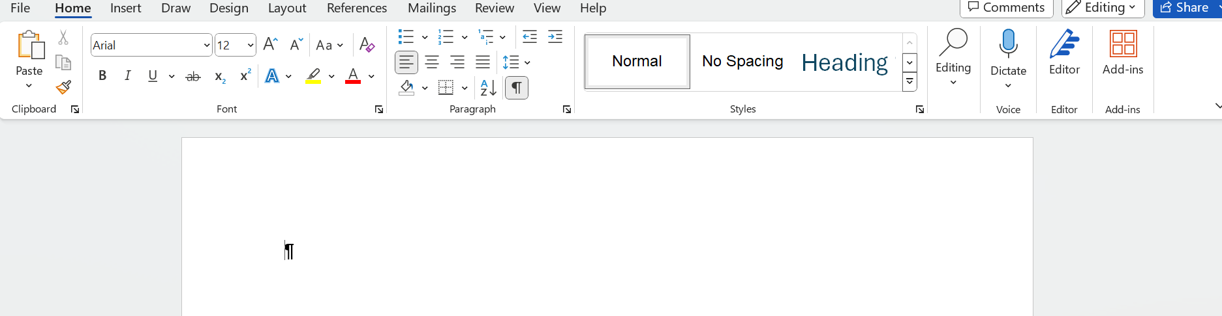
Using Word’s ‘Transcribe’ tool

Slide 15

Using the ‘Transcribe’ tool in Word (1)
Stuart reads from the Shopes paper
Angela reads from the Shopes paper

Slide 16
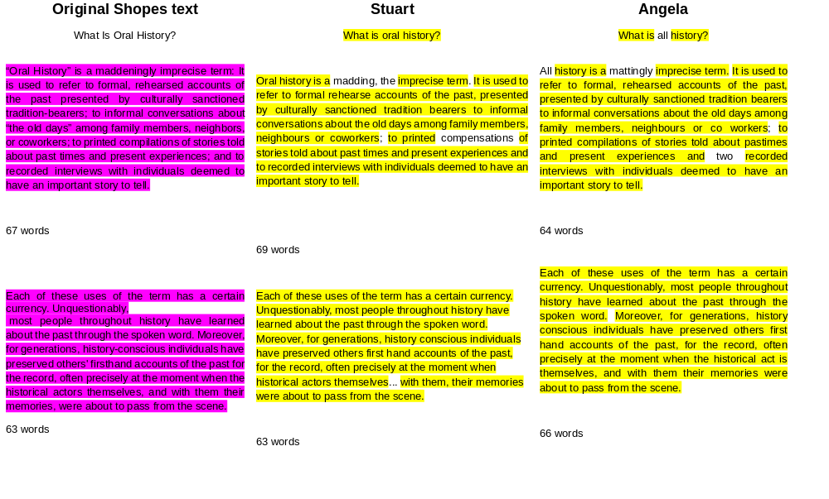

Slide 17
Archiving and storage
“Every effort should be made to ensure oral history materials are adequately stored, processed, maintained, and made accessible according to archival standards and best practices” (Oral History Association, 2022).
Make the interviews discoverable i.e search engine optimisation.
Record in .wav format (can be converted to MP3).
Upload onto web archive.
Ask for library cataloguing or other public archive.

Slide 18
TRANSCRIPTION, TIMECODING & CATALOGUING

Slide 19
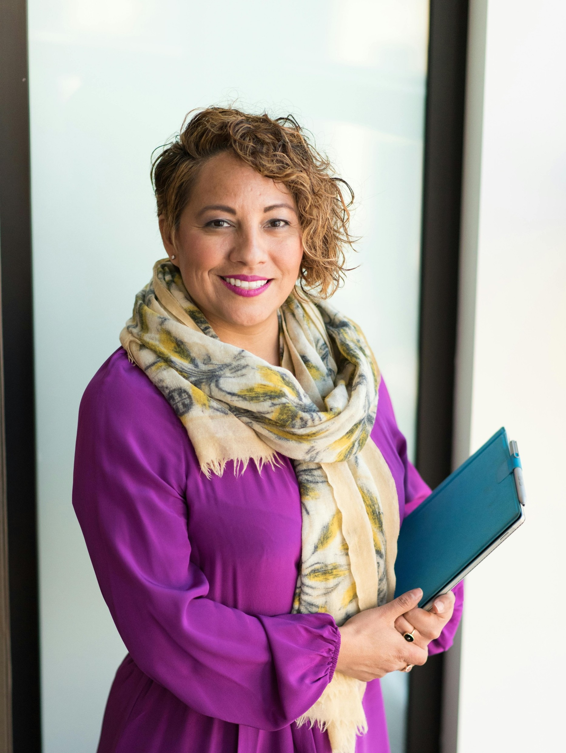
Recording and transcription
How did you record the interview?
Where is it stored?
What format is the file? i.e. .wav; MP3; M4A?
Have you at least two copies of your audio recordings in two separate locations, one on hard drive?

Slide 20
Transcription – guidance notes
Preserving someone’s words in writing verbatim and verifying the interview with your participant is an integral part of the oral history process.
Accuracy spelling of people’s names; place names; names of organisations; institutions and more.
Check acronyms (give in full) and colloquialisms (explain as footnote if necessary).
Add line numbers and timecodes for ease of reference.
Add ‘approved’ and date when verified by your respondent as a watermark.

Slide 21
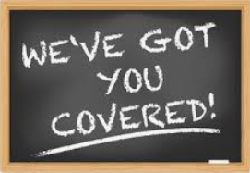


Checking for sensitivities (1)
The guidance on reviewing for sensitivities has supported oral historians for decades so should be viewed positively to protect all concerned rather than as a burden.
As oral historians, we record faithful accounts of the past including the recording of sensitive and/or controversial materials with the principles of informed consent in mind.
As oral historians, we need to be vigilant of any content which could be damaging to the participant. “It will be of no benefit to the oral history program to have a narrator’s reputation damaged through something he said in an oral history interview” (Duke University, 2024, p 1).

Slide 22

Checking for sensitivities (2)
Defamation “is any intentionally false written or spoken communication that harms a person’s reputation or wrongly induces disparaging feelings against that person” (Duke University Libraries, 2024).
Generally, words held to be defamatory relate to “accusations of criminal, unethical, or immoral behaviour, professional incompetence, financial irresponsibility or association with despicable people” (Sommer, 2018, p 4).

Slide 23
Checking for sensitivities (3)
Includes confidential or sensitive information about anyone such as: discussions of personal tragedies, medical conditions, sexual abuse or violence, criminal allegations and defamation against named or identifiable third parties.
The fact that an allegation is in the public domain does not provide us as oral historians licence to repeat it (Digital Repository Of Ireland, 2022).

Slide 24
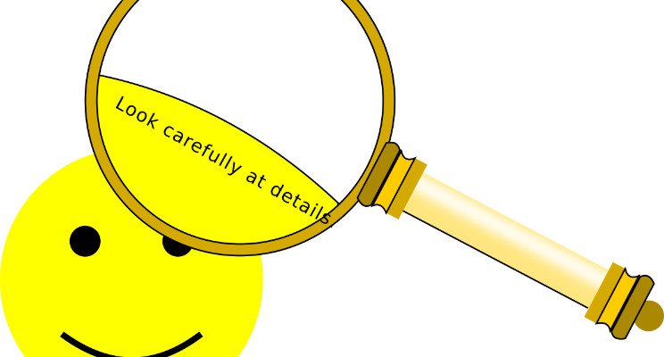
What are we looking for in our oral histories?
Libel (avoid possibility of being sued).
Criminal activity (have a duty to pass on information relating to active criminal investigations to the police in the event of a subpeano/summons).
Safeguarding issues (institutions have a duty of care to children, young people and vulnerable adults).
Sensitive personal information likely to cause substantial damage or distress to living third parties.

Slide 25

The ‘six questions’: red flags
3.Does this interview contain slanderous or liable language?
4.Does this interview reveal trade or corporate secrets?
5.Does this interview use culturally insensitive language?
6.Does this interview reveal sensitive, private information, that could be potentially harmful, about a third party discussed in the interview.
2.Does this interview make criminal allegations against another party?
1.Does this interview contain personal information such as physical address, phone number, or social security number?

Slide 26
References to third parties
Does the recording contain personal information about one or more third parties?
Are some or all of these third parties identifiable?
Are third parties known to be or likely to still be alive?
If one of these third parties is known to be or can be assumed to be dead, is the personal information about them still confidential?
Is the personal information about deceased third parties likely to put someone in extreme danger to their safety or physical/mental health?
If third parties are known or likely to be alive, is the personal information about them sensitive, libellous or confidential?
Is there any corporate information that is still likely to be confidential or libellous?

Slide 27


Slide 28

Exercise 3: Scenarios
“I have heard that the O’ Malley family has paramilitary connections although it’s not something we ever talk about these days.”
“When I look back on it all, I can’t help but think that the university leadership team was more concerned with business expansion that the core mission of providing an excellent education for our students.”
“Jane Jones is a total narcissist. She doesn’t care who she has to stamp on to get higher up the career ladder. She’s always taking credit for my ideas.”

Slide 29
Exercise 3: Scenarios
“I have heard that the O’ Malley family has paramilitary connections although it’s not something we ever talk about these days.”
Reputational damage and potential cause offence.
“When I look back on it all, I can’t help but think that the university leadership team was more concerned with business expansion than actioning our core mission of providing an excellent education for our students.”
Personal opinion
“Jane Jones is a total narcissist. She doesn’t care who she has to stamp on to get higher up the career ladder. She’s always taking credit for my ideas.”
Reputational damage and potential cause offence.

Slide 30
RISK LEVEL | DESCRIPTION | LEVEL OF ACCESS
0 NONE | The recording contains personal data where the data subject cannot be identified either on its own or in combination with other information e.g. a child not mentioned by name with whom an older participant played | Online
1 VERY LOW | The recording contains personal data in which a living individual could be identified but is very low risk because of the wider context. It may contain confidential information but is low risk given passage of time. e.g. a participant whose oral history was recorded in the 1980s says she wants to leave her current job but that she wants to keep this confidential until she tells her current employer | Online
2 LOW | The recording contains personal data or sensitive personal data in which a living individual could be identified, however the personal data in question would be considered low risk because of the wider context. e.g. a recording in 1970s where participant says his neighbour is a member of the Labour Party | Online
3 MEDIUM | The recording contains personal data or sensitive personal data in which a living individual could be identified, however the personal data in question would be considered low risk because of the wider context e.g. participant talks about a former colleague, now 90 years old, positively but references the colleague’s religious practices. | Partial online with redaction
4 HIGH | The recording contains personal or corporate information that is libellous, personal or corporate information that is confidential where the reason for confidentiality has not ceased with the passage of time or sensitive personal data. Publishing the material online or allowing access onsite carries a high risk of causing damage or distress to the data subject or their identifiable living relatives e.g. rumours of an affair between two well known people and suggestion that had a child together. | Partial online with heavy redactions
5 VERY HIGH | The recording contains sensitive personal data which could cause an identifiable individual to be negatively targeted, mentally or physically. Publishing the material online or allowing access onsite carries a very high risk of causing damage or distress to the data subject or their identifiable living relatives e.g. participant says someone is gay and living in a country with strict anti homosexuality laws. | Onsite only

Slide 31
What happens to the original recording?
“It is vital that the original recording is not edited or redacted in any way, but that playback or publicly-accessible copies are generated and then passages muted, each redaction being carefully annotated on any content summaries and transcripts” (British Oral History Society, 2024).

Slide 32

Archiving and storage (1)
“Every effort should be made to ensure oral history materials are adequately stored, processed, maintained, and made accessible according to archival standards and best practices” (Oral History Association, 2022). Sources ‘born digital’ are unlikely to be easily accessible in the next 8 – 10 years.
Make the interviews discoverable i.e search engine optimisation.
Record in .wav format (can be converted to MP3).
Upload onto web archive.
Ask for library cataloguing or other public archive.

Slide 33

Archiving and storage (2)
Multiple computer external hard disc drives are now favoured over CD-Rs and DVD-Rs for long-term storage.
Make multiple copies and place on both cloud storage, portable disc drives hard discs.
Use RAID (Redundant Array of Inexpensive Disks) ready hard discs.
Find a public repository for your interviews. https://corkfolklore.org/
Your method of archiving should be future proof. http://ohda.matrix.msu.edu/2012/06/the-digital-mortgage/

Slide 34
USING SOUND EDITING SOFTWARE

Slide 35
Time coding – guidance notes
Using audio editing software such as Audacity or Wave Pad, insert ‘time codes’ (markers) to denote particular segments of the audio recording.
See Peter Masterson’s transcript.
Time code

Slide 36
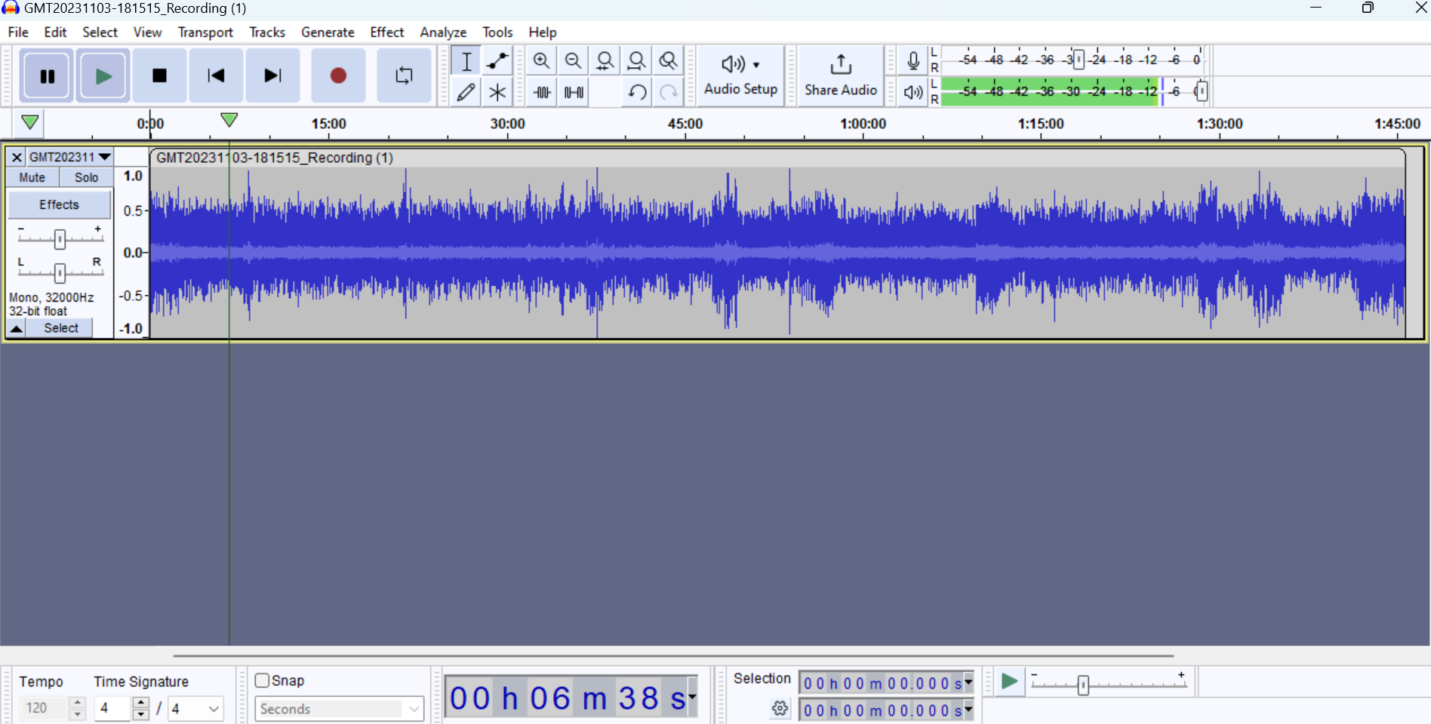
Timecoding

Slide 37
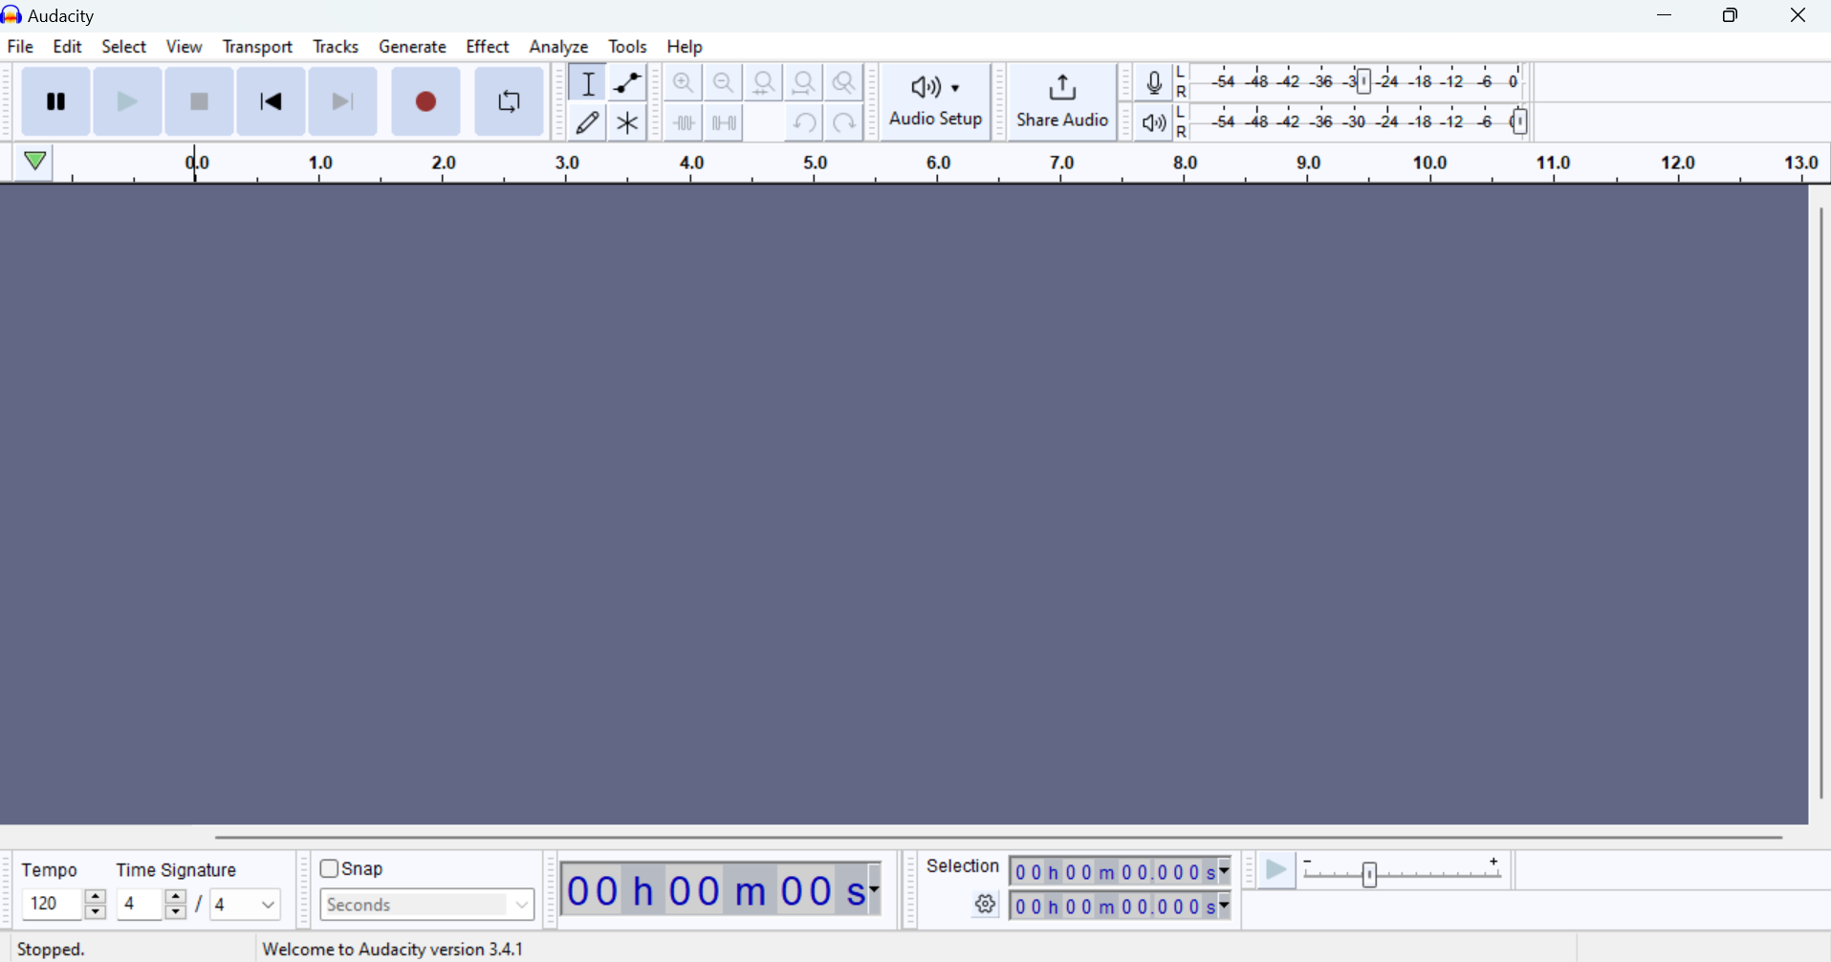
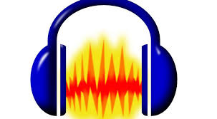
Audacity (1)
Download Audacity

Slide 38
Audacity (2)
AMB: Audacity demo
Introduction to Audacity tutorial

Slide 39
Sharing and storing your oral history
Public archive (retain at least two copies)
Project web site
Youtube (upload image and audio)
Soundcloud.
Itunes
Vimeo
OHMS (Oral History Metadata Syncroniser)
https://openlearnware.tu-darmstadt.de/collection/digital-oral-history-exploring-the-state-of-the-art/ and Digital Repository Ireland resources

Slide 40
Digital preservation
We preserve to ensure than those who need access do have access in the longer term.
Digital preservation is the systematic storage of our oral history recordings. It therefore concerns the system out in place and the people responsible for maintaining that system.
Storage, integrity, control, metadata and content (check regularly for ‘bit rot’.

Slide 41
Digital preservation
Identify relevant files: recordings (format); release forms, transcripts.
Document: catalogue (online and hard copy); project title; length; any restrictions.
Organise: maintain rather than create; consistent naming (name/date i.e. Johnston_Tom_16thOct2018); folders; sub folders
Storage: designate a central storage materials and consolidate all files from other equipment e.g. camera; email etc.
Backup: three copies of your file different locations using three different media e.g. on computer; hard drive(different locations); cloud based storage.
Maintain: spot check for ‘bit rot’; replace is necessary; plan to replace backup drives every 4 – 6 years.

Slide 42
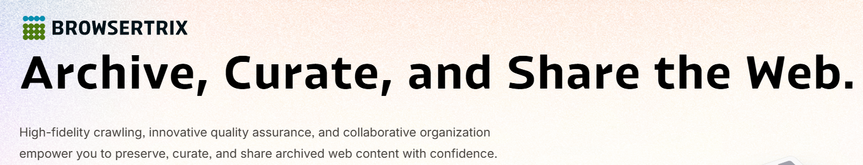
Archiving your web site
https://webrecorder.net/browsertrix/
Installable version of Browsertrix here https://github.com/webrecorder/browsertrix and instructions for installing here https://docs.browsertrix.com/deploy/local/

Slide 43
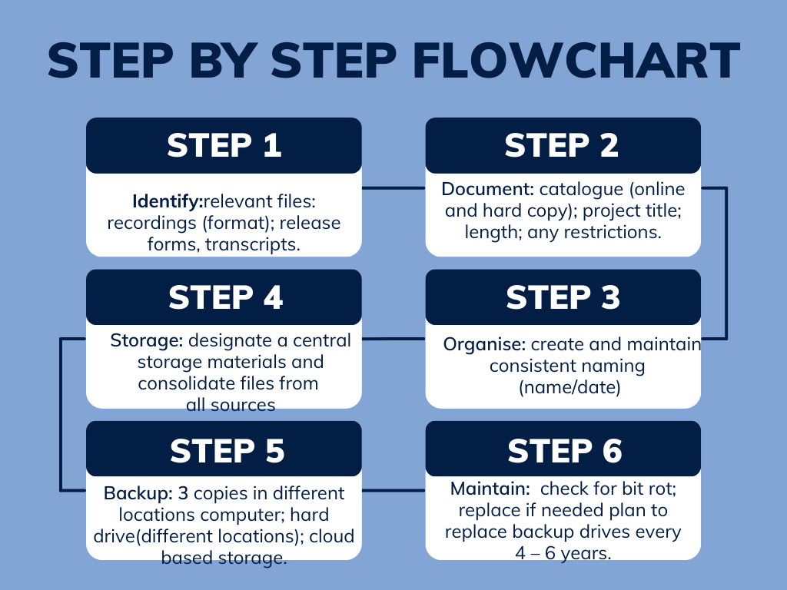
Digital preservation

Slide 44
REVISIT YOUR ORAL HISTORY PROJECT DESIGN

Slide 45

Revisit oral history project design
Your project title
Topic/purpose
Methodology
Scope, time and place.
Potential narrators.
Selected archives
Planned outcomes, including dissemination strategy.
Timeframe for completion.
(One side of A4).

Slide 46
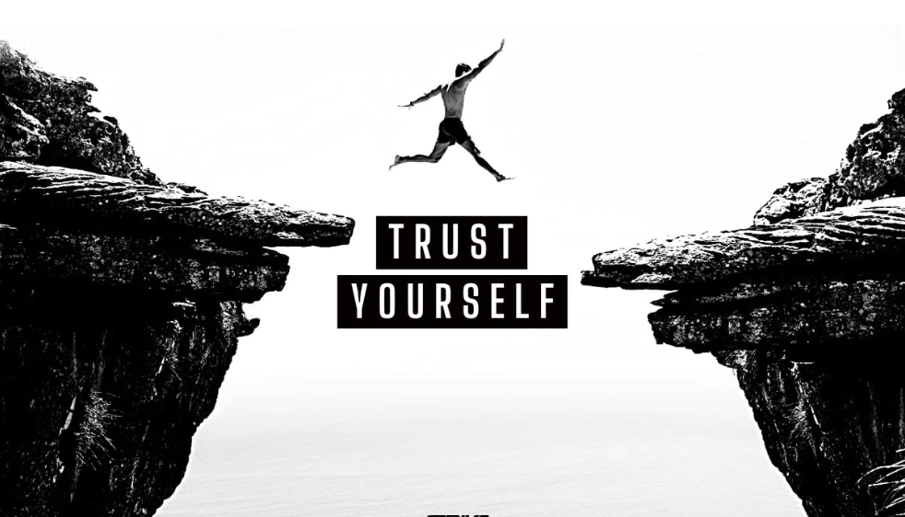
Trust yourself to make the leap from description to analysis

Slide 47
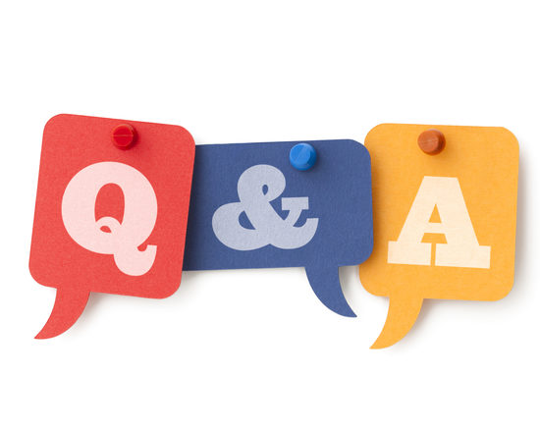

Slide 48
CELEBRATION NEXT WEEK!

Slide 49



Time to celebrate you as an oral historian!

Slide 50
A few final specifics
Angela will be in touch to ask how you would like your name to written on your Certificate of Accomplishment along with course evaluation form.
Your evaluation of the course will help Angela to continuously improve her teaching, mentoring and oral history capabilities so these may be shared with future students.
Staying in touch as a community of oral history practioners; WhatsApp; student showcase events; newsletter
Web page dedicated to you with individual bios on Oral History Made Easy
.

Slide 51
What we covered today
Review and reflection after your first oral history interview: three things that went well, three things you do differently next time.
Transcription including verification, timecoding and cataloguing.
Reviewing for sensitivities: third party references, defamation and risk.
Using sound editing software: Audacity.
Managing your archive and/or placing your recordings in a public archive.
The assignment.
Celebrating your success: next week and beyond.

Slide 52
References
Duke University Libraries (2024) Oral History - Methodologies and Sources, Duke University.
Neuenschwander, J. A. (2014). A guide to oral history and the law. Oxford University Press, USA.
Sommer, B. W., & Quinlan, M. K. (2018). The Oral History Manual. Rowman & Littlefield.
Best Practices for Recording and Preserving Oral Histories (youtube.com)

