Slide 1
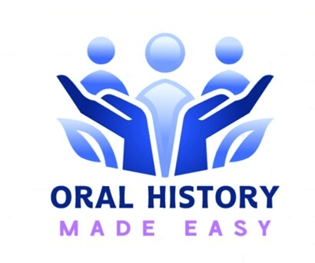
ORAL HISTORY MADE EASY
SPRING 2026 GROUP H
WEEK 1: DECIDE WHAT SORT OF ORAL HISTORIAN YOU WANT TO BE
WELCOME FÁILTE
This class will begin 2 pm GMT
Dr Angela Maye-Banbury
Emeritus Fellow Oral History
Founder Oral History Made Easy
Chairperson Achill Oral Histories

Slide 2
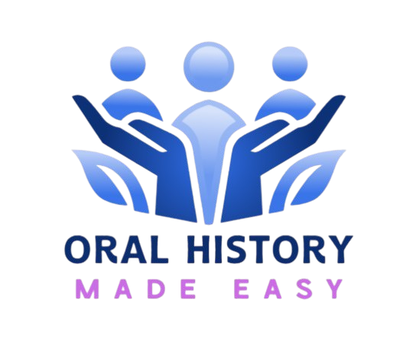
Our 90 minutes together today
Welcome and introductions
Our global community in oral history; why oral history is more important than ever.
About Oral History Made Easy 2026:your experience as a student.
Next steps and Q &A

Slide 3
PhD/
professor academic detective
Museum, library & archivist adventurer
Community heritage advocate
Natural & built environment explorer
Family history warrior
Not for
profit champions

Slide 4
INTRODUCTIONS, WELCOME & COURSE OVERVIEW

Slide 5
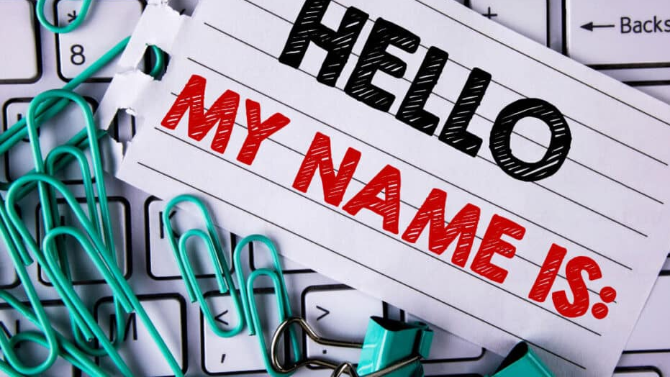
Getting to know one another
“My name is…from…I’m here today because…”

Slide 6
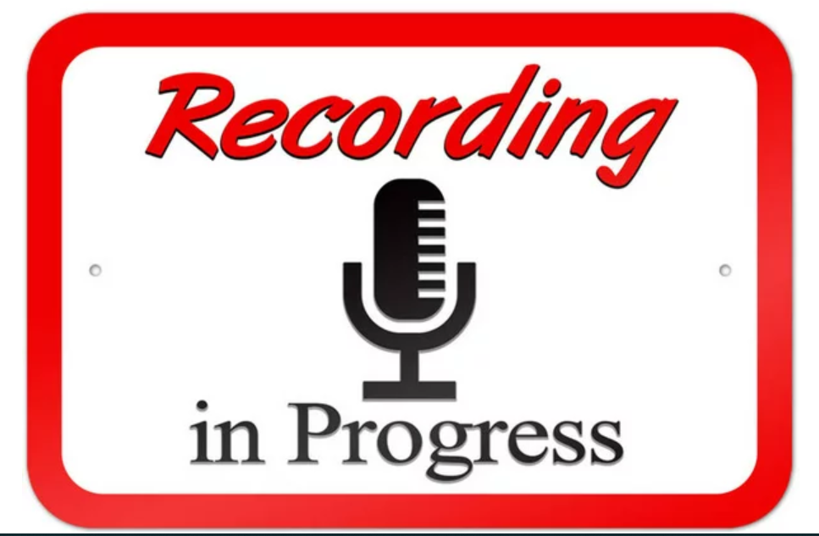

Slide 7

What we will have achieved at the end of today
Introductions, welcome and course overview.
The power of stories, the voice and preservation of the past with oral history.
Conceptualising oral history alongside other ways of recounting life experiences.
Your positionality as an oral historian: importance of beliefs and values on your practice as ‘habitus....’
Sharing our hopes and fears thinking about the weeks ahead.
The power of experiential learning and reflective practice.
Tour of your virtual learning environment.

Slide 8
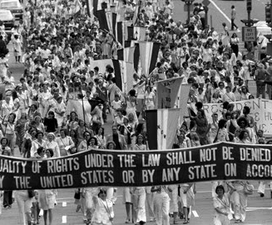
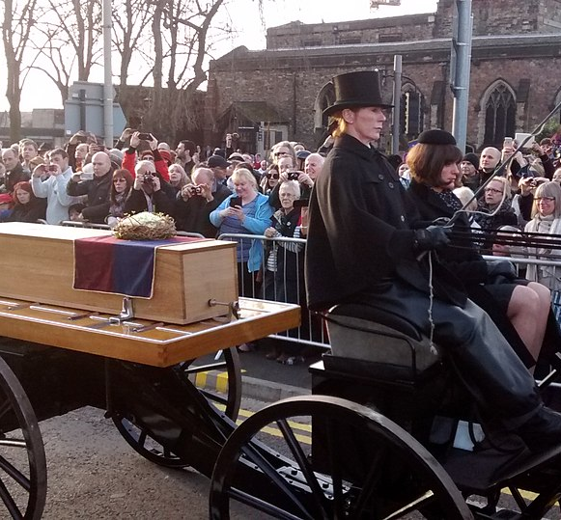
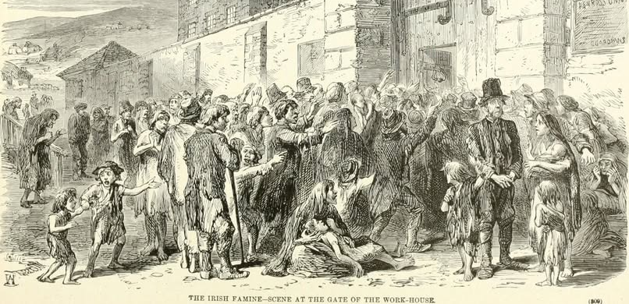
March 22nd in history (1)
1846 (The Famine An Gorta Mór): The Relief Commission issued a report detailing widespread crop failures and dire conditions across Ireland.
1972: The Equal Rights Amendment is passed by the U.S. Senate and sent to the states for ratification.
2015 The coffin of Richard III parade ahead of the reinterment at Leicester Cathedral.

Slide 9
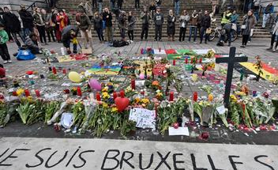
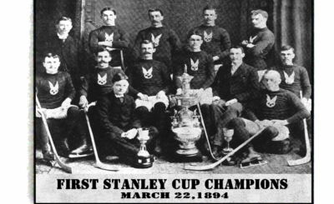
March 22nd in history (2)
2016 Ten year anniversary of Brussel airport bombings.
1894 World’s first ‘Stanley Cup Championship’ in Canada.

Slide 10
Individual and collective memory
Individual
memory
Collective memory
Past in the present

Slide 11
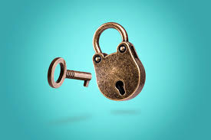
In oral history, memory is both the lock and the key.

Slide 13
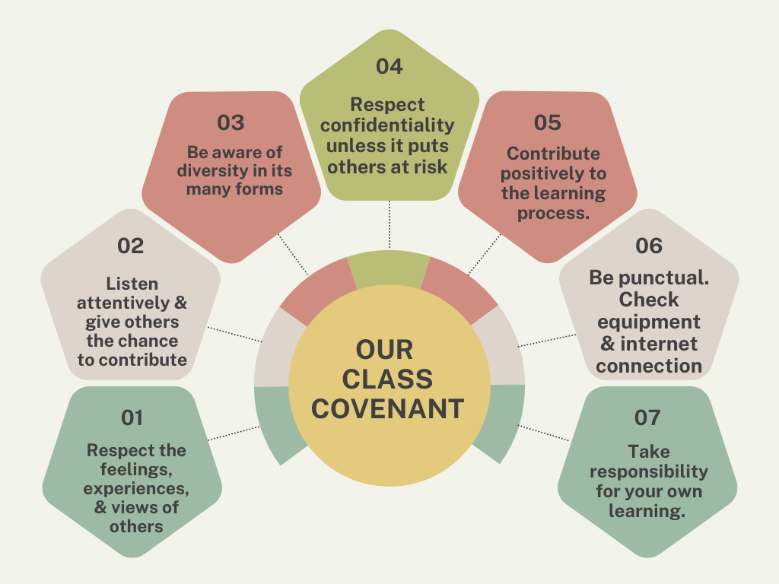
Our class covenant

Slide 14
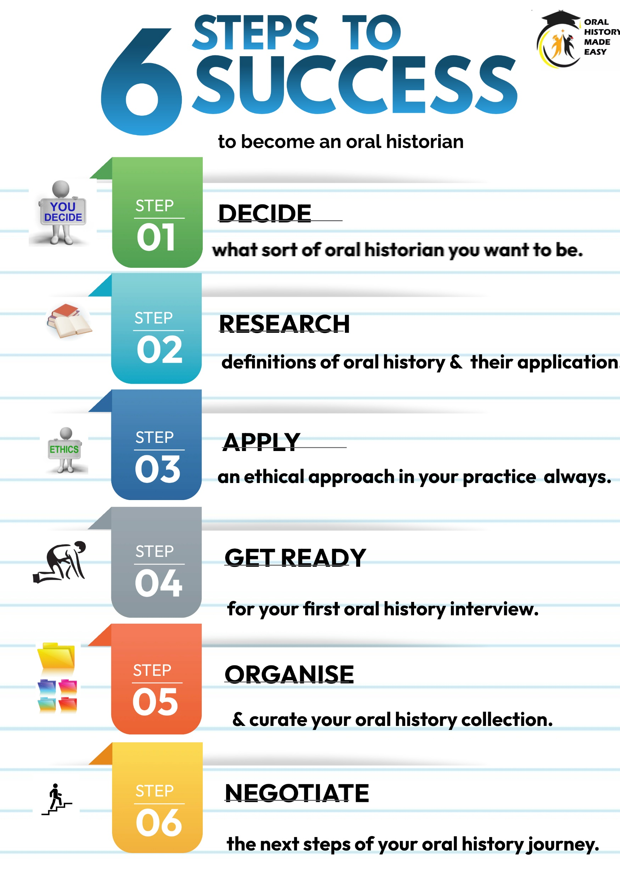

Proprietary
DRAGON FRAMEWORK
Completion of training needs analysis
1:1 Mentorship with AMB 30 mins x 2
Motivation hub meetings x 2
End point assessment (1,000 words)
Celebration event & award of certificate of participation

Slide 15

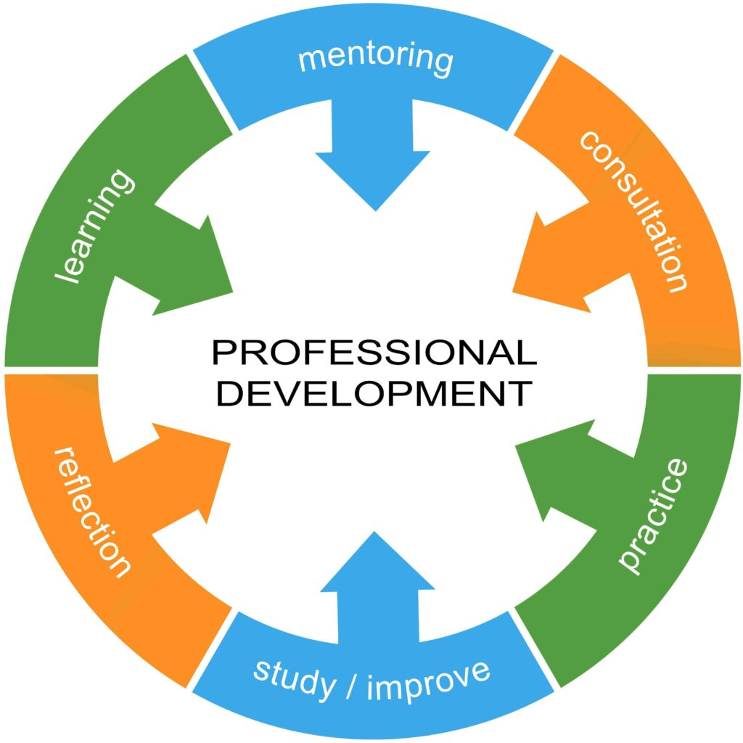


I AM AN ORAL HISTORIAN!

Slide 16
THE POWER OF STORIES: THE VOICE & PRESERVATION OF THE PAST WITH ORAL HISTORY

Slide 17
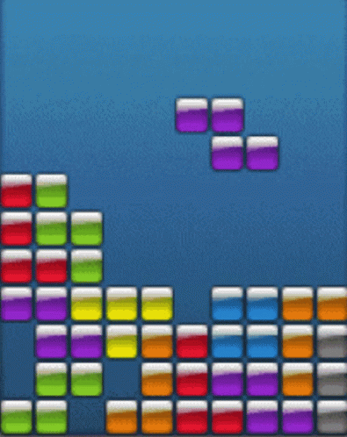
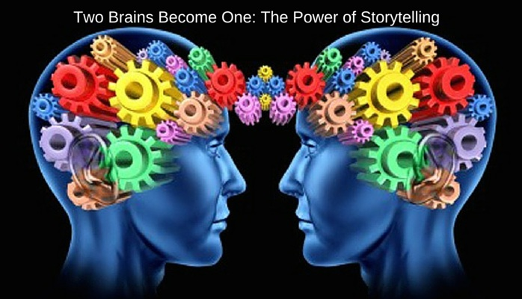
We are hardwired to share stories
We are hard wired to share our stories. ‘Neurons that fire together, wire together.’
When we hear a good story, whether factually based or otherwise, our brains actually light up causing the neurons to fuse together. This process is known as ‘neuron coupling’ Stephens et al (2010); Carolla et al (2025).
Stories are memorable. Our brains crave a sense of order and an ability to assign meaning to past events.

Slide 18




The importance of one to one interaction for empathy building
One to one dialogue equals ‘onesness’ and ‘overlap of selves’ (Ciandini et al , 1997; Oceja, 2014).
Our ability to show empathy and change the way we act and what we believe decreases the more people are involved: ‘compassion fade’ (Butts et al, 2019).

Slide 19
SOS - Save our stories
Our communities are bursting to the seams with extraordinary stories. Yet seldom are these precious accounts recorded and preserved for future generations.
Once lost, these are lost forever. Or they may be rewritten by others with ideological goals in mind.
Oral history is a people’s history. Think ‘histoire’ (story and history). It places the narrator at the heart of their unique story as told on their own terms being skilfully steered by the oral historian.
.

Slide 20
Digital amnesia: the volatility of the internet
Research highlights that the ever-changing nature of online materials means much of what is created today may not survive into the future without intentional preservation efforts. For example, web content can disappear, change, or become inaccessible undermining its value as a historical record (Balogun, 2025)
Broken links, ‘link rot’ error 404 over which we have no control. Without proactive digital preservation, the digital footprints of lived experience may be lost
.

Slide 21




I want to hear your voice
The voice has much more impact on us that reading text.
Hearing someone’s voice has a profound emotional impact on us. This is because the brain first processes speech for the emotion in sounds in the amygdula. Those sounds then become the words that create a connection between speaker and listener (Brück et al 2011; Seydell-Greenwald et al 2020).
Interpersonal communication where the voice is present creates stronger social bonds than where just text (SMS; email) is used.

Slide 22
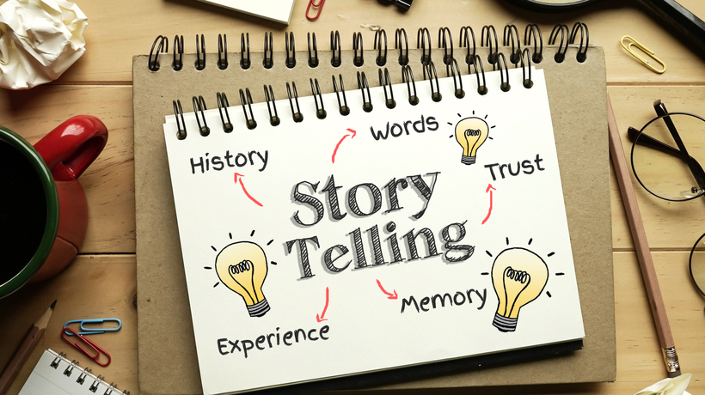
Exercise 1
Whose story do you want to save while you still have the chance?

Slide 23
Oral history as ‘traces of history’ (1)
“Most human affairs happen without leaving vestiges or records of any kind behind them. The past, having happened, has perished with only occasional traces…And only a part of what was observed in the past was observed by those who observed it. Only a part of what was remembered was recorded. Only a part of what was recorded has survived. Only a part of what has survived has come to historian’s attention; only a part of what has come to their attention is credible” (Gottschalk, 1950, p 460).
“More history than ever is today being revised or invented by people who do not want the real past, but only a past that suits their purpose” (Hobsbawm, 2002: 296).
INFORMATION – MISINFORMATION – DISINFORMATION – QUEST FOR KNOWLEDGE

Slide 24
The death of ‘born digital’ sources?
“It cannot be stated clearly enough that born-digital records are highly ephemeral and, like paper records, must be consciously preserved over time. Without continual stewardship, the pace of technology advancement in software and hardware can render such records inaccessible in under 8-10 years. Beyond that point, the skills required to resurrect and interpret data from obsolete hardware, operating systems and software applications approaches those of digital forensics. This is a highly specialised and expensive field. Most data may be deemed not worth the effort.”
(National Archives Advisory Council, 2020, p 10).

Slide 25
Exercise 2
Read the transcript of Tom Johnson’s interview from p 1, start of para 1 “It’s very vague really….” until p 2, end of para 1“common throughout the village.”
What impression have you formed of Tom just from reading his transcript?
Now listen to Tom’s voice Part 1 to 3 mins 05 secs
What impression do you now have of Tom having heard his voice?

Slide 26
CONCEPTUALISING ORAL HISTORY

Slide 27

Oral history in a continuum of stories
Oral history is…
Reminiscence work is…
Life story work is…
Nostalgia work is…
Personal narratives are…
Eyewitness accounts are…
Storytelling is…

Slide 28
Conceptualising oral history (1)
Oral history is the systematic recording, preservation and curation of people’s accounts of life in audio format so they may be accessible to current and future generations often as part of a public archive.
Storytelling is the interactive art of using words and actions to reveal the elements and images of a story while encouraging the listener’s imagination.
Nostalgia work is a sentimental longing or wistful affection for the past often triggering high level emotion

Slide 29

Conceptualising oral history (2)
Reminiscence work is a facilitated discussion about the past often using photos, objects and music to stimulate mental activity wellbeing.
Life story work is a way to reconnect people, often those who are vulnerable, with their past to empower them in the future.
Personal narratives are an account of past events written in the first person about a particular period or event in history.
Eyewitness accounts (or testimonies) are descriptions given by someone who was present at an event.

Slide 30
YOUR POSITIONALITY AS AN ORAL HISTORIAN: VALUES, BELIEFS & LIFE EXPERIENCES.

Slide 31

Decide what sort of an oral historian you want to be
Importance of ‘habitus’ & your ‘positionality.’

Slide 32
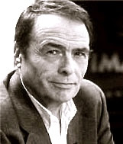
The importance of habitus in oral history
Who do we think we are? A ‘hard habitus to break’.
Habitus: socialised norms and tendencies that guide the way in which we act and behave.
Conceived by Pierre Bourdieu, French philosopher and sociologist.
1930 - 2002

Slide 33
What are the beliefs and values which have drawn you to oral history?
The life experiences which have drawn me closer to oral history are…
The beliefs (our convictions drawing on learned experiences and contexts which do not need proof) which have drawn me closer to oral history are…
The values (the relative worth I attribute to something which transcends context) which have drawn me closer to oral history are…

Slide 34
HOPES & FEARS FOR THE WEEKS AHEAD

Slide 35
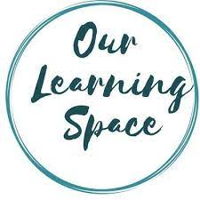
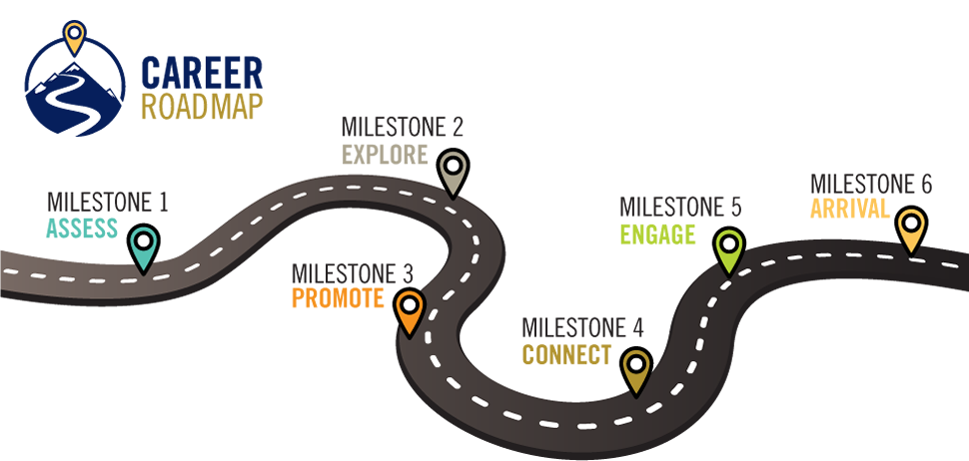
Your development journey, your way
Your past, present and future experiences

Slide 36
Hopes and fears
MY HOPES | MY FEARS

Slide 37
EXPERIENTIAL LEARNING & REFLECTIVE PRACTICE

Slide 38
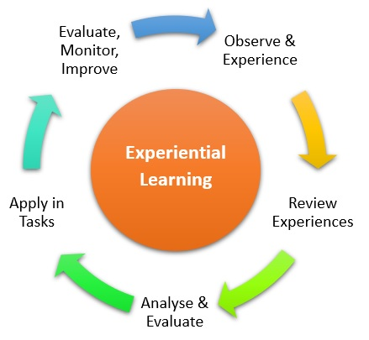
Experiential learning
The power of reflective practice
Our ability to engage in deeper learning is enhanced by reflective practice

Slide 39

The Six Step Programme To Success
DRAGON
Framework
KNOWLEDGE, SKILLS & ATTRIBUTES
YOU NEED TO BECOME
AN ACCOMPLISHED ORAL HISTORIAN

Slide 40
1.
Promote your confidence and capability in oral history through experiential learning
2. Empowering you to practice oral history through mentorship and peer support
3.
Promoting ethical practice are present at every stage when conducting oral history
4.
Future proofing your oral histories through digitisation
5.
Optimising your oral histories through dissemination
ORAL HISTORY MADE EASY
PROGAMME PRINCIPLES

Slide 41
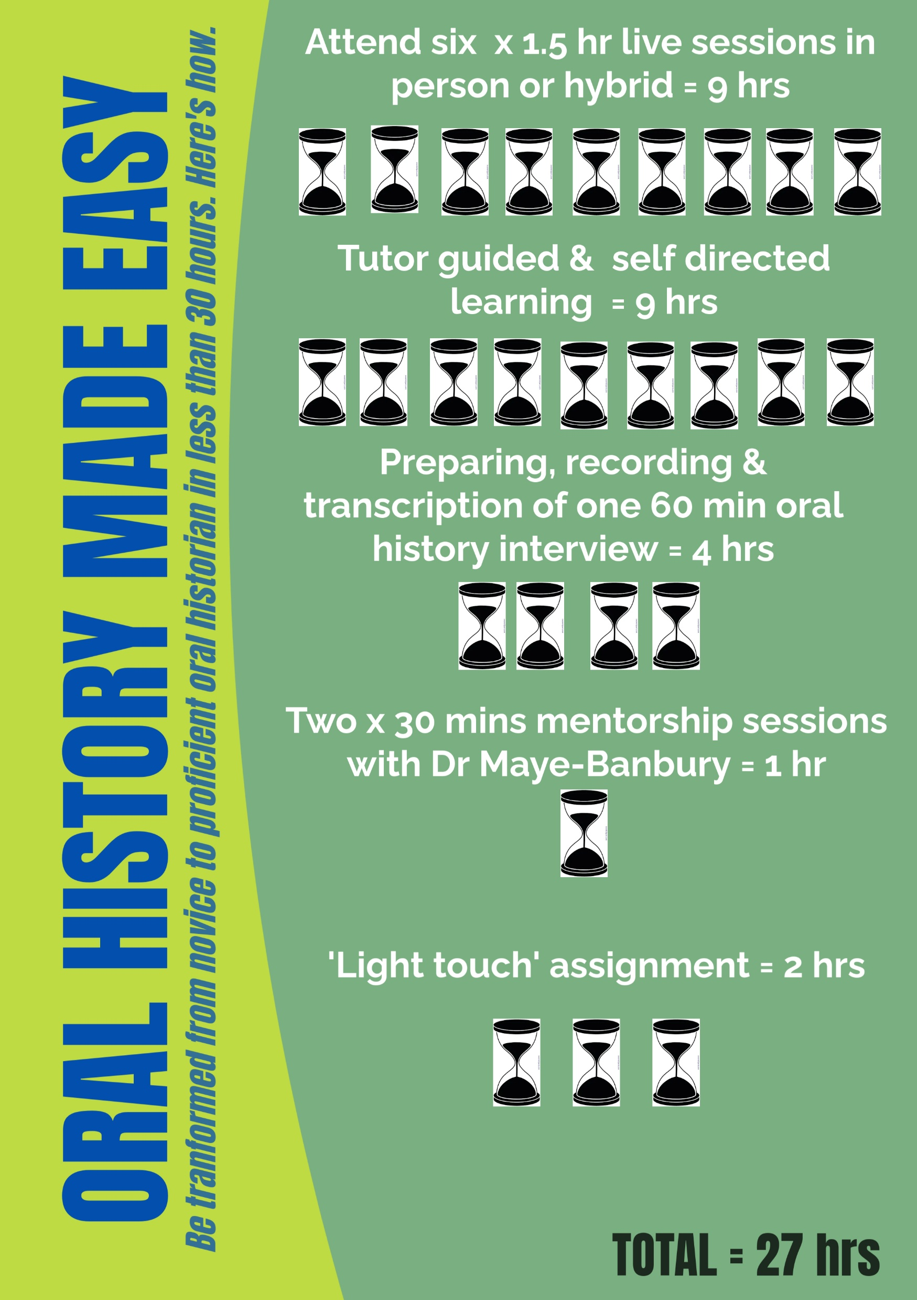


Slide 42


Two student community meetings in next 6 weeks, the first of which is next week 1.30 pm Ireland/GMT

Slide 43
TOUR OF YOUR VURTUAL LEARNING ENVIRONMENT

Slide 44
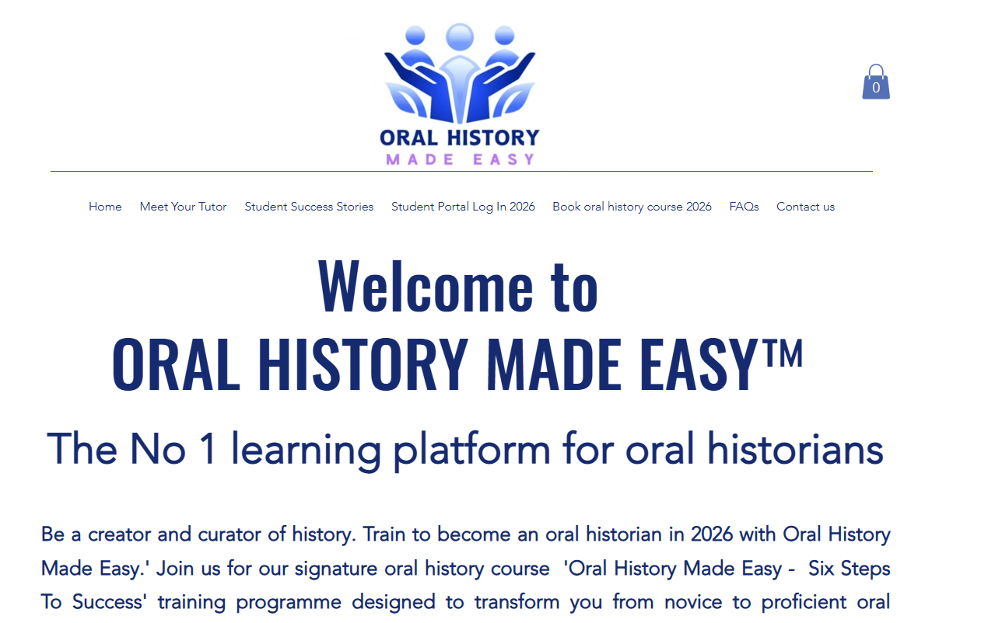
Accessing the student portal (1)
Two stage process
1.Log on the Oral History Made Easy web site and click on the ‘Student Portal Log in 2026’ in the top right hand corner. The portal is password protected. The password is Mystudentlogin1

Slide 45
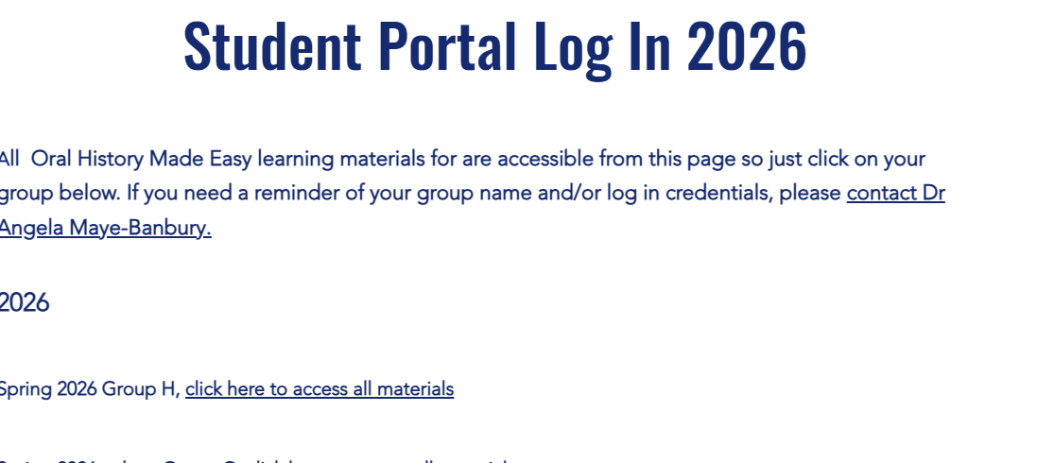

Accessing the student portal (2)
Now go to the ‘Group H Summer 2026 Cohort – click here to access all materials’ tab and use the password Oralhistorian10 to log in.

Slide 46
Week 1 folder
ESSENTIAL TARGETED LEARNING MATERIALS SPRING 2026
Zoom links for all six weeks SPRING 2026

Slide 47
Tasks for week 2
Write around 100 words between now and next week which outline your hopes and fears for the completion of the course. NB Save your reflections safely as they really useful when you write the final 1,000 word report (or equivalent) in which you will chart your progress on the course and outline a future action plan for your ongoing development.
Read Linda Shopes’ article ‘Making sense of oral history’ in week 1 resources. What is the value of oral history, according to the author?

Slide 48
What we have covered today
Explore the power of stories, why we need to preserve oral histories now and listening to the voice..
How we conceptualise oral history alongside other ways of recounting life experiences.
Your positionality as an oral historian: importance of beliefs and values on your practice as ‘habitus.’
Sharing our hopes and fears thinking about the weeks ahead.
The power of experiential learning and reflective practice
Tour of your virtual learning environment

Slide 49
References
Gottschalk, L. (1950). Understanding history: A primer of historical method. Knopf.
National Archives Advisory Council (2020) Annual Report 2020, National Archives Advisory Council: Dublin.
Sharpless, R. (2008). ‘The History of Oral History’. In Thinking about Oral History. Theories and Applications. Thomas L. Charlton, Lois E. Myers, Rebecca Sharpless (eds) Baylor University, 7-32.
Shopes, L. (2011). Oral history. The SAGE Handbook Of Qualitative Research, 451-465.

