Slide 1

ORAL HISTORY MADE EASY
MODULE 2: Deciding what sort of an oral historian you want to be
Monday 6th January 2026
With DR ANGELA MAYE-Banbury BA MSc PhD SFHEA
ORAL HISTORIAN & EMERITUS FELLOW IN ORAL HISTORY

Slide 2
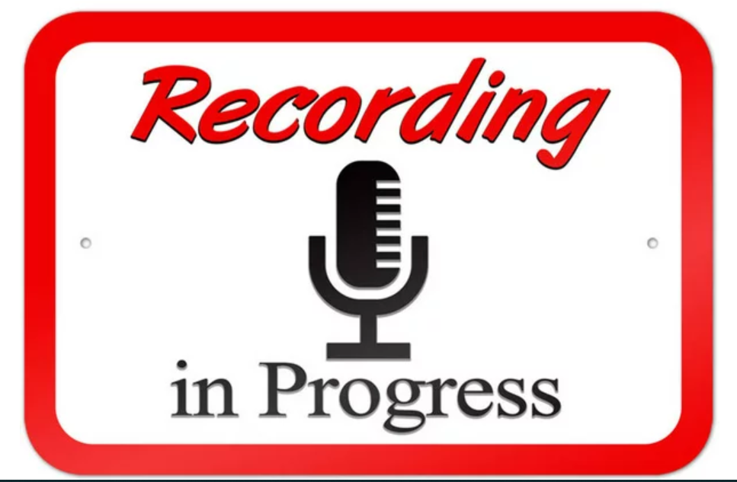

Slide 3

What we will have achieved at the end of today’s session
The emergence of oral history and exploring definitions of oral history.
The emergence of modern day oral history practice: a note on narratives and
defining oral history.
Memory as a process: the ‘unreliable’ witness; evoking our memories; the subjectivity of oral history; individual/collective memory.
Your oral history challenges (i) Identify one resource which you think will be of valuable
to everyone; (ii) The listening challenge (iii) Explore the professional organisations which support oral historians in their everyday practices.

Slide 4


What one thing do you remember from module 1?

Slide 5
THE EMERGENCE OF ORAL HISTORY & EXPLORING DEFINITIONS

Slide 6
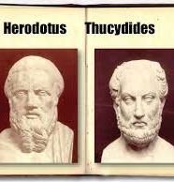
The emergence of oral history
The first ever oral historian is generally regarded to have been Thucydides (c.460 BC c 400 BC) chronicled nearly 30 years of war and tension between Athens and Sparta using eyewitness accounts.
Mention must also be given to Herodotus 425 BC whose accounts of history were infused with myth, legend and narratives of triumph.

Slide 7
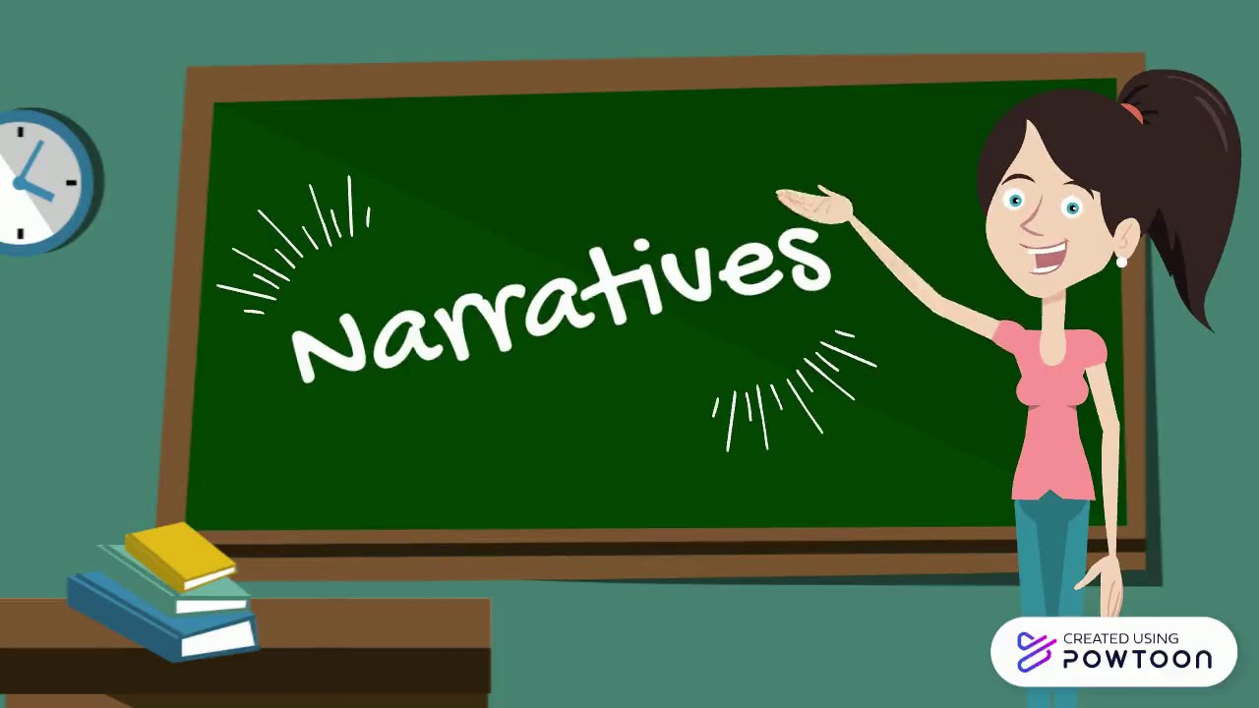
A note on narratives
We need to be always vigilant when considering how narratives are formed, by whom and why.
Meta narratives: a plot or backstory widely accepted in society presented top down in such a way as to minimise critique; associated with modernism. Even the emergence of oral history itself is often presented as a metanarrative.
Micro narratives: individual accounts such as oral histories which are generated from the bottom up recounted by those who have born witness to past events; associated with postmodernism.
And everything in between…

Slide 8
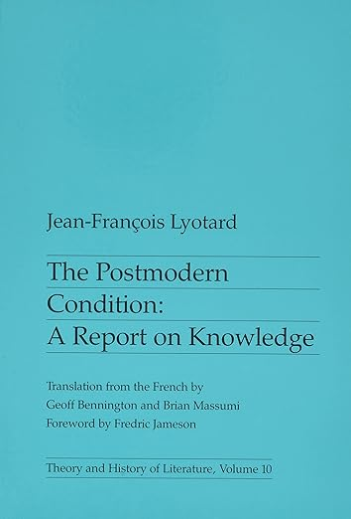
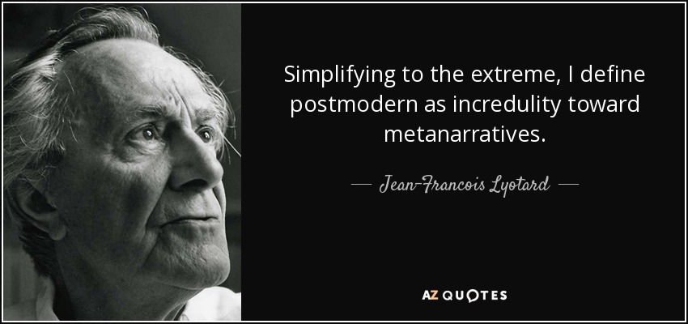
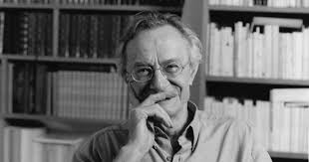
Petites histories – little stories
Jean-François Lyotard (1924 – 1988)
French philosopher, sociologist, and literary theorist.

Slide 9
Exploring the emergence of modern day oral history practice
Allan Nevins 1948 from Columbia University began to record spoken memories of white male elites (Yow, p 3) including politicians, business and civic leaders.
Improvements of technology meant that oral history began more popular with the advent of the cassette recorder and much more besides.
Studs Terkel 1912 – 2008: saw oral history as a tool for social justice
Listen to Studs Terkel’s oral history interviews

Slide 10


Defining oral history (1)
Oral history is a people’s history; concerns events of the past recounted in an individual’s own words. Silent voices, hidden stories and personal narratives.
“The interviewing of eyewitness participants about in the events of the past for the purposes of historical reconstruction” (Grele, 1996: 63 in Thomson, 1999).
"Memory is the core of oral history. Put simply, oral history collects memories and personal commentaries of historical significance through recorded interviews" (Richie,2014: 1).

Slide 11


Defining oral history (2)
“Oral history is the recording of personal testimony derived in oral form for purposes beyond the recording itself” (Yow, 2014 p 4).
“Oral history draws on memory and testimony to gain a more complete or different understanding of a past experienced both individually and collectively” (Bornat, 2004).
The method of gathering, preserving and interpreting the voices of people, communities and participants in past events…the sharing and maintenance of stories (OHA, 2024) Watch this short film by Oklahoma Oral History project.

Slide 12
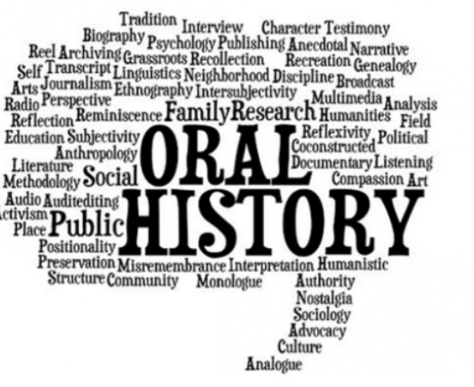
Defining oral history (3)
Oral history is: (i)the recording itself (ii)the transcript and (iii)the practice.
Interdisciplinary practice which yields rich primary data which can be applied to a diverse range of contexts.
Recordings are intended to be accessible and often kept in public repositories.
British Library Sound Archive; East Midlands Sound Archive; Columbia Centre For Oral History; Achill Oral Histories.
Professional communities of practice: Oral History Society; Oral History Network Of Ireland; Oral History Association.

Slide 13





What makes oral history different
Gives us access to undocumented rich life experience to generate ‘thick descriptions’ of past events.
Enables us to understand how experiences felt and their consequences
Allows us to have a dialogue with interviewees enabling them to assign meaning to past events.
Allows us to focus on aspects of life rarely documented
Hidden histories of people whose voices have been neglected or misrepresented to create a ‘shared authority’ (Frisch, x)
Adopted from Thomson (2009)

Slide 14

Capturing real life experiences

Slide 15
Exercise 1
In your own words, write a definition of oral history
Think of one group whose voices have been marginalised from accounts of the past.
How MIGHT ORAL HISTORY MAKE THIS GROUP’s STORY MORE ACCESSIBLE?

Slide 16
MEMORY AS A PROCESS:
THE ‘UNRELIABLE’ WITNESS & EMBRACING SUBJECTIVITY

Slide 17
Key issues – oral history and memory
With audio recordings and verbatim records of our experiences, we are able to report on those experiences faithfully. Without documenting, each iteration of the story will shift.
In an oral history interview, people seldom recount their experiences chronologically – and in a moment, we shall see why. What is the relevance of the tangents?
Our inability to remember our lives aged between – 3 (approx) and our limited recollections of past experiences until we are around 10 years old is called ‘infantile amnesia’ and is attributed to evolving neurological development in the early years of our lives (Callaghan et al, 2014).

Slide 18
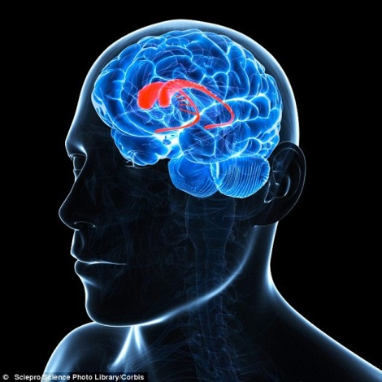

The mechanics of memory
Hippocampus: long term memory; strong; emotional.
Visual stimuli: pictures more 'memorable' than words.
Sensory stimuli.
Marilee Sprenger's work on memory:
"The brain is programmed to forget, it filters out about 99 percent of incoming information. This usually allows us to focus and keep our sanity.“
Attention and intention.
Prefrontal cortex: short term memory.
Tales around 7 repetitions for something to go from short to long term memory.

Slide 19
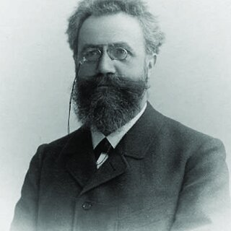
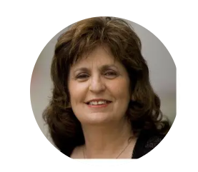
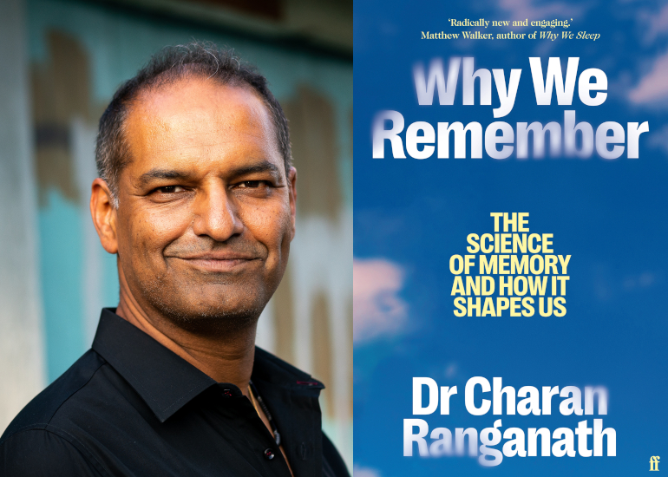
Pioneers of memory
Hermann Ebbinghaus
Marilee Sprenger
Charan Ranganath

Slide 20

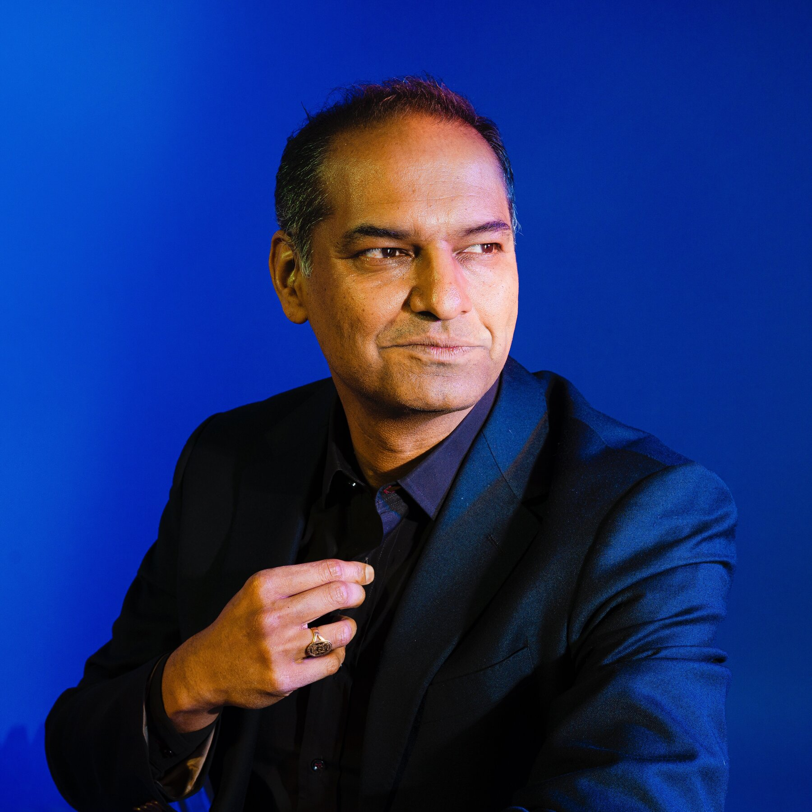
Why we remember – and why we forget

Slide 21
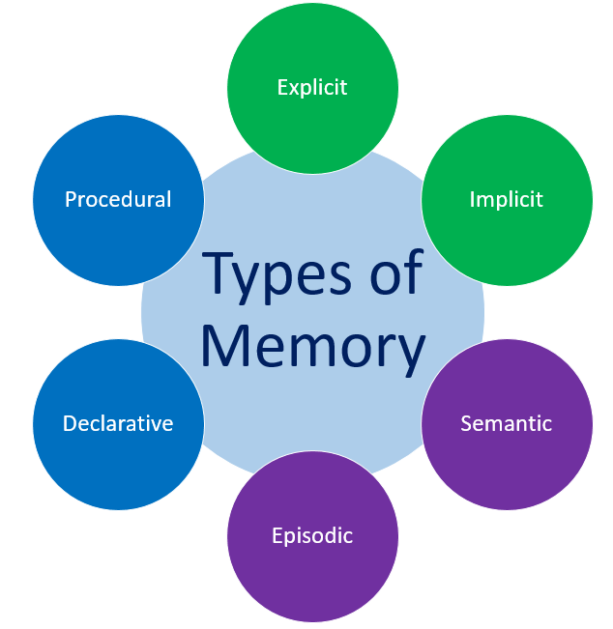
Implicit - remembering things subconsciously by rote e.g. knowing the route to home or work
Explicit - consciously remembering things e.g. appointments.
Procedural - remembering how to perform a task or skill e.g. riding a bike; using software.
Declarative - remembering facts; faces; phone numbers.
Episodic - remembering recall of personal experiences at specific moment.
Semantic e.g. recalling facts triggered by words/phrases.

Slide 22
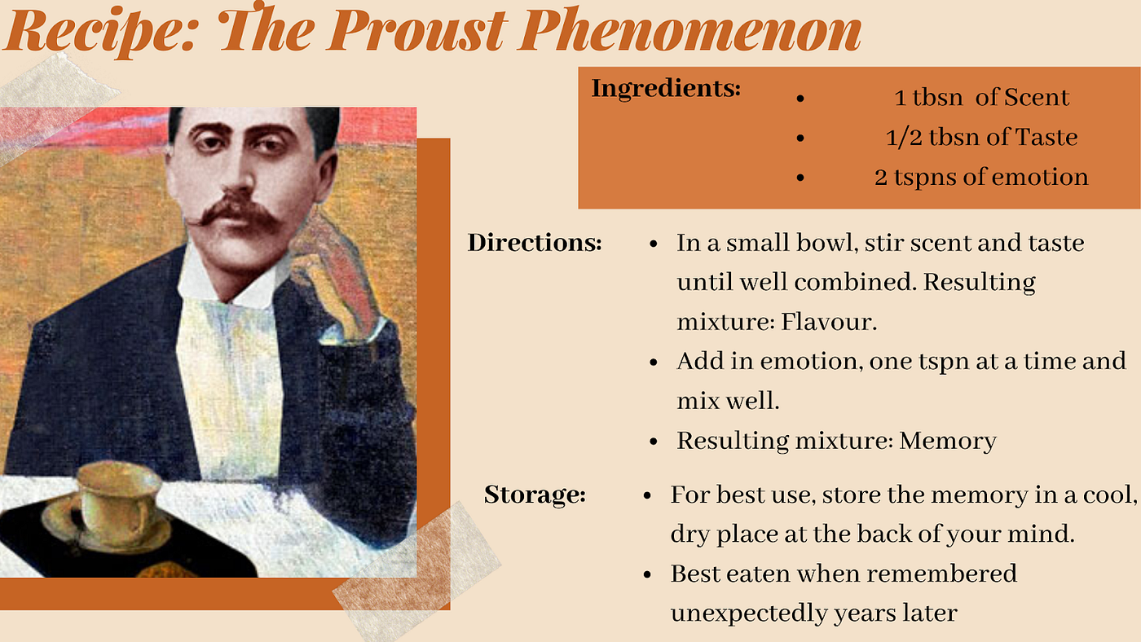
Exercise 2: What scent/aroma gives you a Proustian rush?

Slide 23
Things that help us remember
Stories | Stories have emotional components that attract the amygdale, the emotional centre of the brain. They also have beginnings, middles, and ends that make sense to the hippocampus, the structure that helps store these episodes.
Humour | Humour, laughter, and joyfulness release important brain chemicals that make us feel good and aid in retention. Some research suggests that we remember at least 30 percent more of what we learn with humour.
Games | Learning through play is one of the most powerful ways to learn. Limiting competition is important.
Analogy | Creating assists brains in connecting new information to what it is being compared to.
Metaphor | Oral History Made Easy is like a delicious buffet of tasty knowledge.
Movement | Active, hands-on learning will bring back memories of prior movement and movement patterns

Slide 24

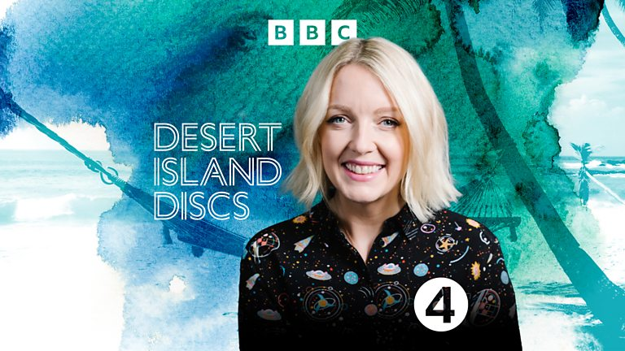
Exercise 3: Musical memory moments
Soundtracks of our lives.
Choose a song that evokes particular memories for you.
BBC’s Desert Island Discs Series
Eight tracks, a book and a luxury: what would you take to a desert island?

Slide 25
Narrators as ‘unreliable’ witnesses
Oral histories are coded, decoded and recoded at multiple points.
Oral histories contains insights framed by context, layers of time and experience of the narrator. It is how people remember from a ‘web of meaning’(Abrams, 2014, p 89).
“What is really important to remember is that memory is not a passive depository of facts but an active process in the creation of meanings” (Portelli, 2002).

Slide 26
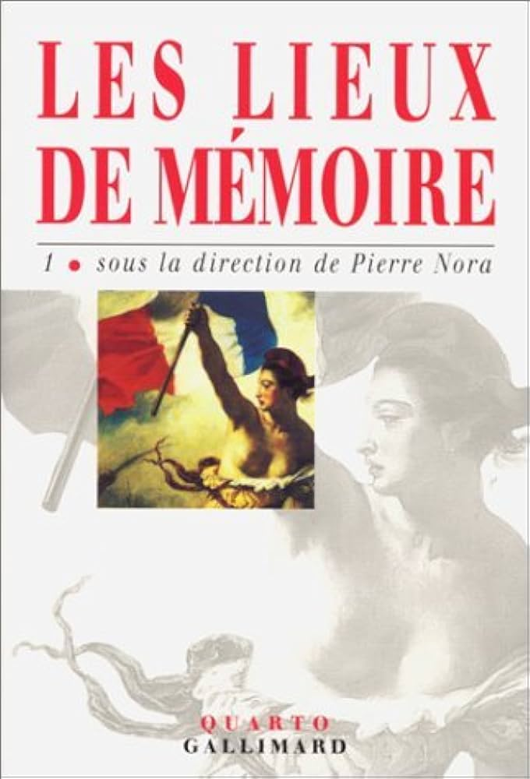
Fallibility of human memory
The role of memorials: purpose and prospects.
Sites of memory may be:
- Physical
- Digital
- Imagined.
Pierre Nora & sites of memory.

Slide 27
Embracing (& interrogating) subjectivity
Importance of habitus.
“One precise advantage of oral evidence is that it is interactive and that one is not left alone, as with documentary evidence, to divine its significance. The source can reflect on the content and offer interpretation as well as facts” (Lummis, 1988).
“The importance of oral testimony may often lie in not in its adherence to facts but rather in its divergence from them where imagination, symbolism and desire break in.” (Portelli, 2002).

Slide 28
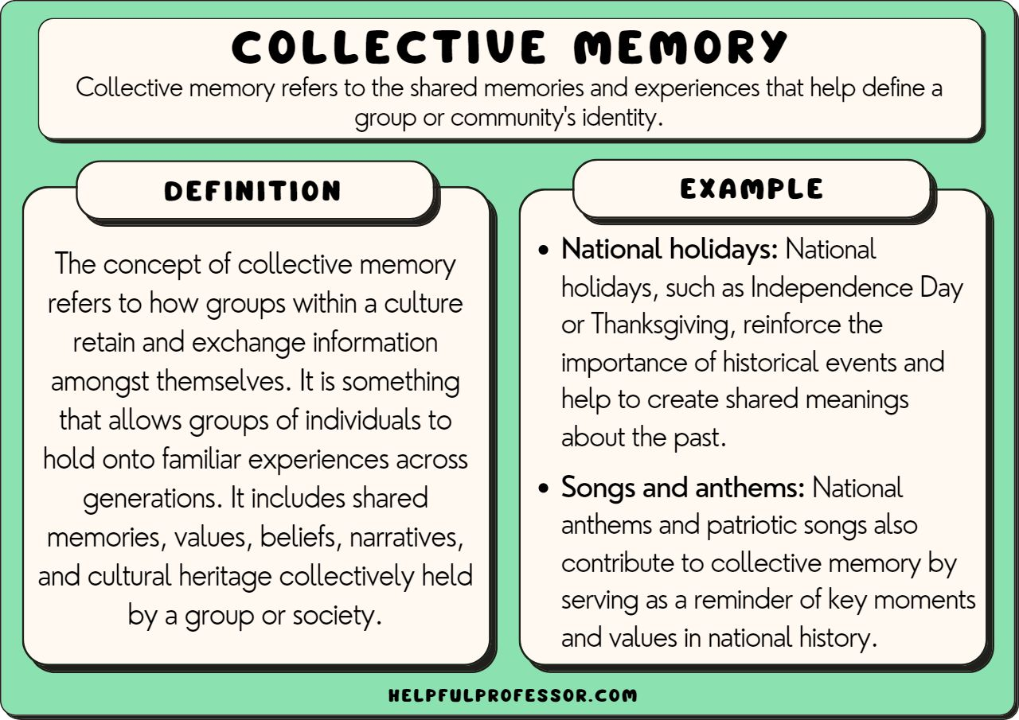
Individual & collective memory

Slide 29
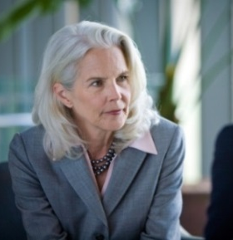
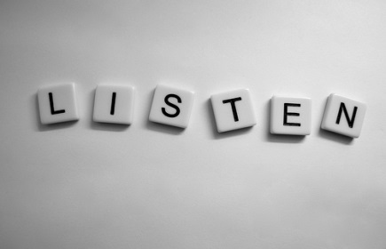
Listening challenge 1
The importance of the interviewer's and interviewee's "inner voices" (Roberts, 2020) in non-judgmental way.
Enables interviewer to ask more appropriate questions; indicates to respondent that you have been listening.
The art of "hearing data" (Rubin and Rubin, 2011).
Audit interview transcripts; look at proportion of interviewer and interviewee speaking.
Actively listen; avoid thinking of quality of final recording.
Minimal interviewer interruptions: be comfortable with silences.

Slide 30
The listening challenge (2)
Between now and next week, find someone with whom you can speak for 30 mins (this could be divided into 2 x 15 mins slots or 3 x 10 mins slots. This can be in person, online or on the phone/WhatsApp.
Safeguard informed consent by telling your co-conversationalist that you are doing this exercise as part of Oral History Made Easy. Your partner will be anonymous.
Try and use a ‘naturally occurring’ conversation. Use as many open ended questions as possible. You can focus on something specific “Tell me about a place you loved as a child.” Or you can simply begin by asking “What are you planning to do today?” “How was your day?” Make a discrete note of the time.
Resist the temptation to graft your own autobiographical experiences onto the conversation or tell anecdotes. Be fully present in the conversation.

Slide 31
The listening challenge (3)
Immediately (or as soon as practical),after you have completed the 30 mins, make some notes on:
(i) How much of the conversation you remember. Make a note of content (headlines); chronology; anything that stood out.
(ii) How you felt when you were actively listening; the extent to which you were able to focus entirely; you level of interest; your energy levels.
For tips on active listening, see our top ten tips.

Slide 32
The loop of understanding: words, emotions and feeling
Communicate
Observe
Check
Understand

Slide 33
STUDENT LEARNING COMMUNITY

Slide 34
Your one to one mentorship sessions
AMB to be in next week touch to arrange your 30 mins one to ones.

Slide 35
Tasks for module 3
Your reflections on hopes and fears; notes from two book chapters, beliefs and values and Linda Shopes’ paper and portfolio development.
Find one oral history resource you like and think could be useful to the group. This can be in any format! Please email your resource to Angela oralhistorymadeeasy@gmail.com for sharing with the group on or before 14th Jan 2026
2. The listening challenge: 30 mins of active listening with reflections between now and next week.
3. Explore professional communities of practice: Oral History Society; Oral History Network Of Ireland; Oral History Association. What are your three key takeaways following your review of these web sites?

Slide 36

Next session
Saturday 17th January 2026
10 am EST Cleveland time/6 p.m. Ireland GMT

Slide 37
What we have achieved at the end of today’s session
Your reflections on hopes and fears; experiences, beliefs and values and Linda Shopes’ paper: your ‘student community hubs.’
The emergence of oral history and exploring definitions of oral history.
The emergence of modern day oral history practice: a note on narratives and
defining oral history.
Memory as a process: the ‘unreliable’ witness; evoking our memories; the subjectivity of oral history; individual/collective memory.
Your oral history challenges (i) Identify one resource which you think will be of valuable
to everyone; (ii) the listening challenge (iii) Explore the professional organisations which support oral historians in their everyday practices (iv) Listening challenge.

Slide 38


Slide 39
References
Abrams, L. (2014). Memory as both source and subject of study: The transformations of oral history. Writing the history of memory, 89-109.
Bornat, J. (2004) ‘Oral history’ Qualitative Research Practice, 34-47.
Callaghan, B. L., Li, S., & Richardson, R. (2014). The elusive engram: what can infantile amnesia tell us about memory?. Trends in neurosciences, 37(1), 47-53.
Grele [1973] 1996, 63) in Thomson A. ‘Making the Most of Memories: The Empirical and Subjective Value of Oral History,’ Transactions of the Royal Historical Society. 1999;9:291-301. doi:10.2307/3679406.
.

Slide 40
References (contd)
Lummis, T. (1988). Listening To History: The Authenticity Of Oral Evidence. Rowman & Littlefield.
Portelli, A. (2002). What makes oral history different. In The oral history reader (pp. 77-88). Routledge.
Ritchie, D. A. (2014). Doing Oral History. Oxford: Oxford University Press.
Turnbull, O., & Solms, M. (2004). Memory, amnesia and intuition: a neuro-psychoanalytic perspective. In Emotional development in psychoanalysis, attachment theory and neuroscience (pp. 63-92). Routledge.
Yow, V. R. (2014). Recording Oral History: A Guide For The Humanities And Social Sciences. Rowman & Littlefield.

Slide 41
Additional resources
Introduction To Oral History – Texas Digital Library
Development And The Use Of Oral History

